Slide 1
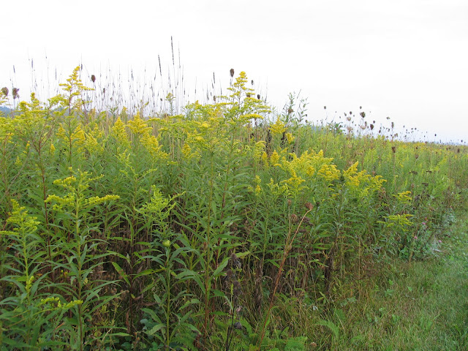
What to do with all our data?
Tomomi Suwa and Liz Schultheis
GK-12 Workshop Session

Slide 2
Diversity
Productivity
Coexistence

Slide 3
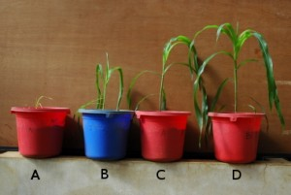
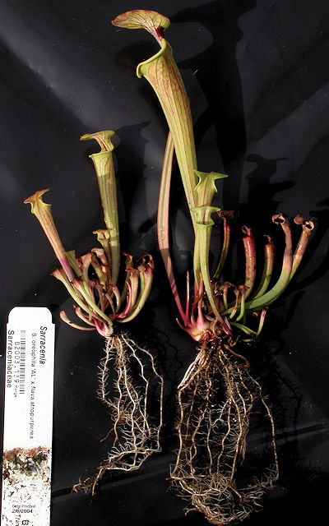
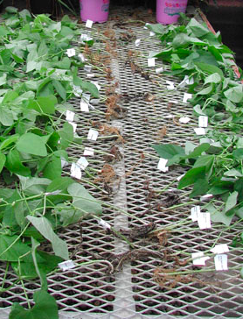
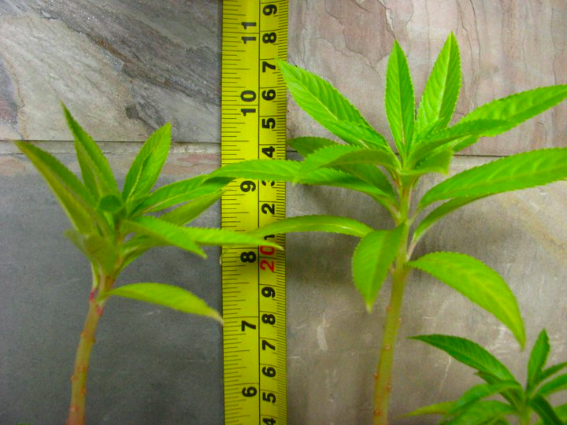
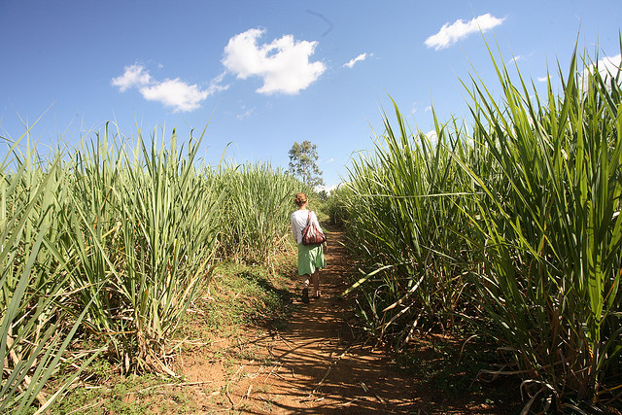
Nutrients and Productivity
Notes:
There is a ton of evidence that supports that by adding fertilizer, plants grow larger and are more productive. Why we apply fertilizers to crops. This might sound like a really simple concept so why are we adding fertilizer as one of the treatments in our BEST experiment?

Slide 4
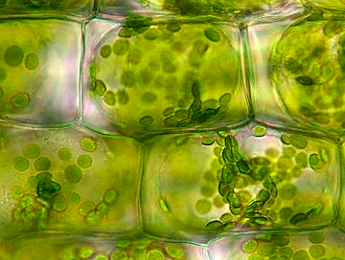

Proteins, enzymes, metabolic processes, part of chlorophyll
Plants grow larger and produce more seeds and fruits

Slide 5
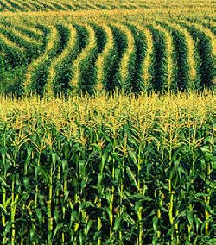
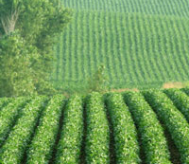
Nutrients and Productivity in Plant Functional Groups
While plants benefit from fertilization, not all plants will benefit to the same extent.

Slide 6

Nutrients and Productivity in
Grass
Grass species are notorious for needing high levels of nitrogen fertilizers
They grow quickly and are browsed commonly by insects and mammals

Slide 7
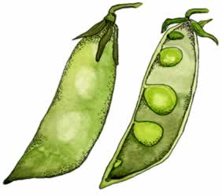
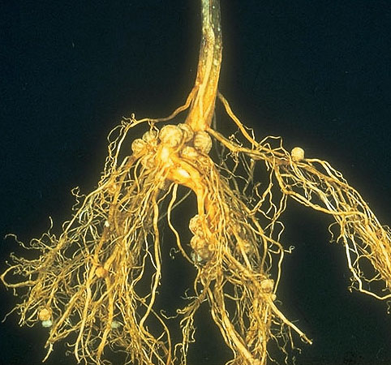
Nutrients and Productivity in Legumes
Legume plants have rhizobia bacteria living in their roots, helping them fix nitrogen

Slide 8
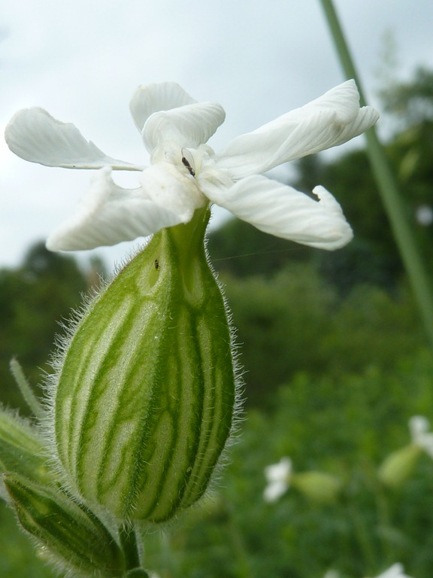
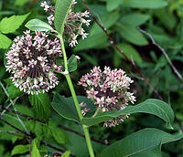
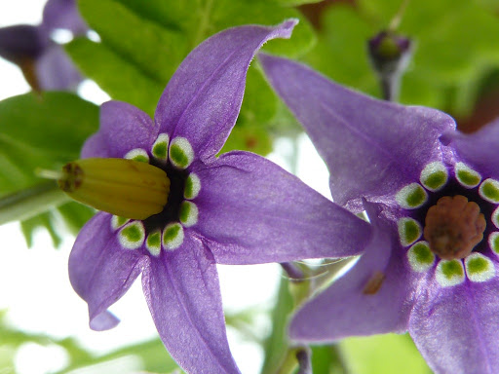
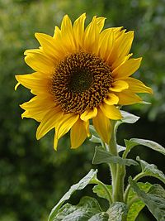
Nutrients and Productivity in
Forbs
Forbs = broad leaved, non-woody non-grass species. Commonly found in old fields and meadows.
Forbs are a very diverse and variable group of plants
Some forbs have high nitrogen requirements, while other require very little

Slide 9
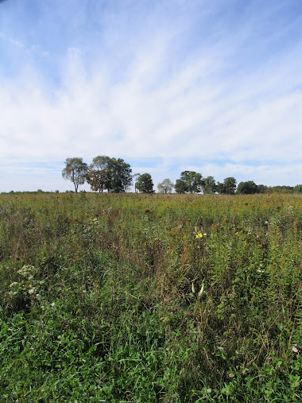
Nutrients and Diversity
If fertilization affects different groups of plants in different ways, what do you predict fertilization will do to species richness (# species)?

Slide 10
Our Questions:
How does nutrient addition affect diversity and productivity?
Does nutrient addition affect diversity and productivity of groups of plants in different ways?
      Grasses
      Legumes
      Forbs
Notes:
Diversity, productivity, coexistence

Slide 11
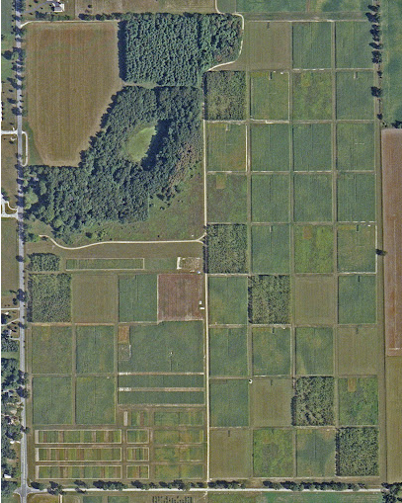
Experimental design of schoolyard plots parallels the T7 treatment at the KBS LTER.
Successional fields with a diversity of grass, legume, and forb species.
Nitrogen fertilizer addition treatment.

Slide 12
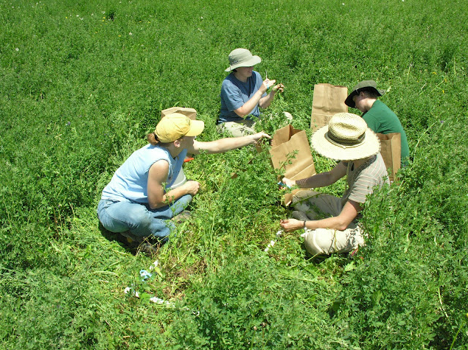
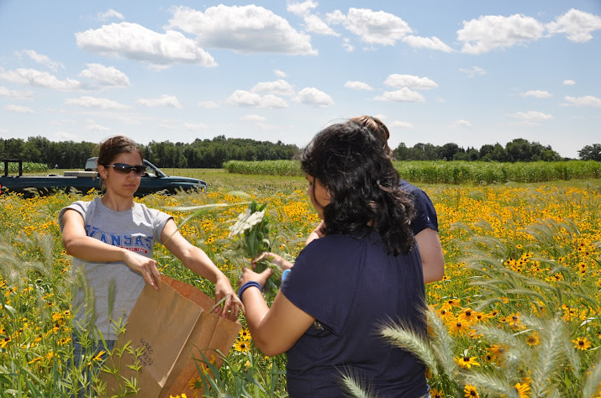
Every year collect subset of biomass to determine plant productivity.
Measure the diversity of species.

Slide 13
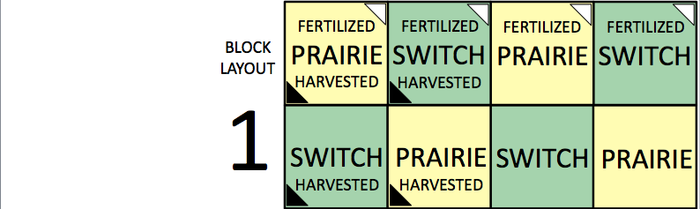
What are the equivalent treatments in the BEST plots?
How does fertilization affect diversity/productivity?

Slide 14
LTER Data Set
5 sheets
    Raw data
    Richness 2003 Data
    Biomass 2003 Data
    Richness over time (1989-2003)
    Biomass over time (1989-2003)
    Go to excel spread sheets:

Slide 15
What specific questions can we ask?

Slide 16
Our Question:
Do grasses and legumes respond differently to N addition?
What do you predict?
-richness
-biomass
We’ll address this question as a group!

Slide 17
Our Question:
Do grass and legume respond differently to N addition?
Break into 4 groups
Grass Richness
Grass Biomass
Legume Richness
Legume Biomass
Forb Biomass

Slide 18
e.g. How did forbs respond to Nitrogen addition?
SE
Average
SE
Forb Biomass (g)
No
N Addition
N Addition
Notes:
What am I plotting here?
-average
-Standard error

Slide 19
To calculate Standard Error (SE):
-Two-step process
=var (A1:A6)
=sqrt (var(A1:A6))/# replicates)

Slide 20
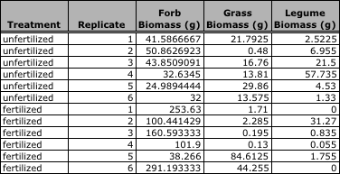
Let’s go to Excel and graph the data
Data from year 2003
Notes:
For t-test

Slide 21
e.g. How did forbs respond to nitrogen addition?
Forb Biomass (g)
How can we tell the difference??
No
N Addition
N Addition

Slide 22
Analyze the data with T-test
  Used to determine if two groups are considered different

Slide 23
P-value
The p-value tells whether or not two groups are different
If p ≤ 0.05, two groups are different
If p > 0.05, two groups are NOT different
e.g. p=0.013
N-
N +
Notes:
E.g. p=0.013 If we repeat this experiment 100 times, 1/100 times would we expect to see a difference by chance. 99 times, we’ll find the answer accurately (i.e. confidence).

Slide 24
Let’s go to Excel to do t-test!
4 groups:
Grass Richness
Grass Biomass
Legume Richness
Legume Biomass

Slide 25
What did you find?

Slide 26
Graphs: Richness and Biomass 2003
Grass
Legume
Richness
Biomass (g)

Slide 27
Does the effect of N fertilization change over time?
Notes:
How can we address this question?

Slide 28
e.g. forb biomass
Forb biomass (g)
Year

Slide 29
Does effect of N change over time?
Forb biomass (g)
Is this pattern real??
Year

Slide 30
Does effect of N change over time?
Plot scatter graph
Forb biomass (g)
r = -0.24
P = 0.39
r = -0.50
P = 0.06
Is this pattern real??

Slide 31
What did you find?

Slide 32
Richness and Biomass 1989-2003
Grass
Legume
Richness
Biomass

Slide 33
Do grasses and legumes respond differently to N addition?
How does N addition affect richness and productivity? ( or )
Each group fill the table
 | Richness 2003 | Biomass 2003 | Richness Over time | Biomass Over time
Grass
Legume

Slide 34
Notes:
LTER Data

Slide 35
Notes:
LTER Data

Slide 36
Comments/questions?

Slide 37
 | Richness 2003 | Biomass 2003 | Richness Over time | Biomass Over time
Grass | 0 | 0 | - | +
Legume | - | 0 | - | -

Slide 38
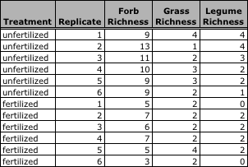
Functional Group Richness
Data from year 2003
Notes:
For t-test

