Slide 1
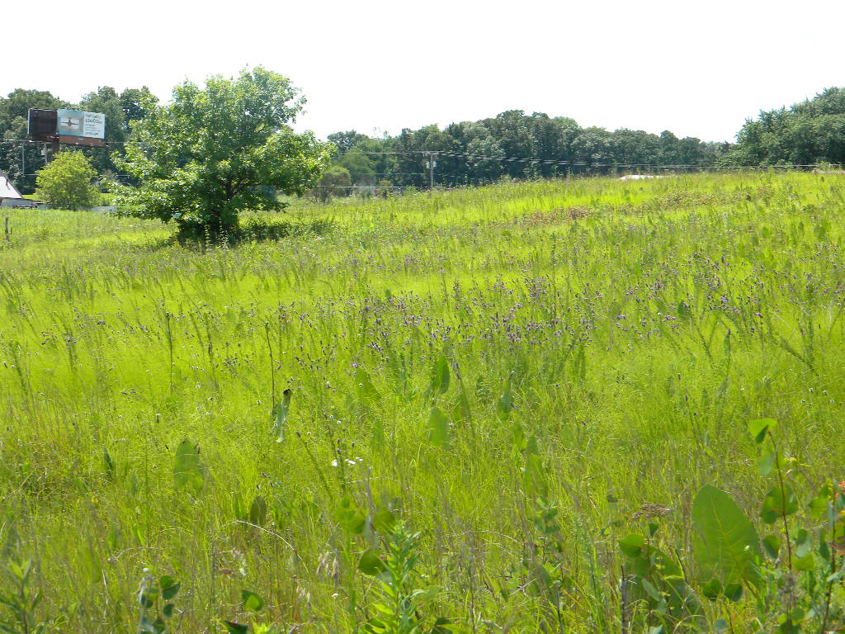
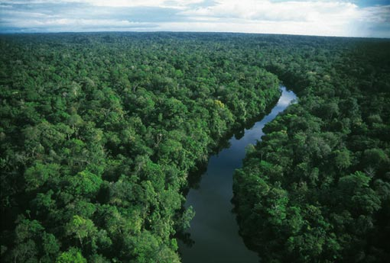
What is biodiversity?
The variety of living things in a place
Worldwide: 2 - 30 million species
900,000 insect species
400,000 plant species
10,000 bird species
Where is Biodiversity?
20-30 plant species per m² in North American grasslands
More tree species in 50 hectares than in all of North America in the Amazon

Slide 2
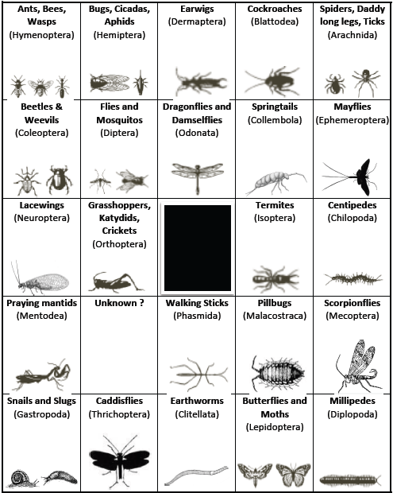
Exploring Biodiversity:
Bugs Galore!

Slide 3
Kingdom
Phylum
Class
Order
Family
Genus
Species
Animalia
Chordata
Mammalia
Primate
Hominidae
Homo
Homo sapiens
Notes:
Invertebrates are different from us at the Phylum level: “Chordata” means we have a spine, and “invertebrate” means they don’t.
We are differentiating the invertebrates mostly at the level of Order: think of other Mammals and how different we are from them (dogs, cats, whales, etc.) – that is the same level of difference we are looking for.

Slide 4
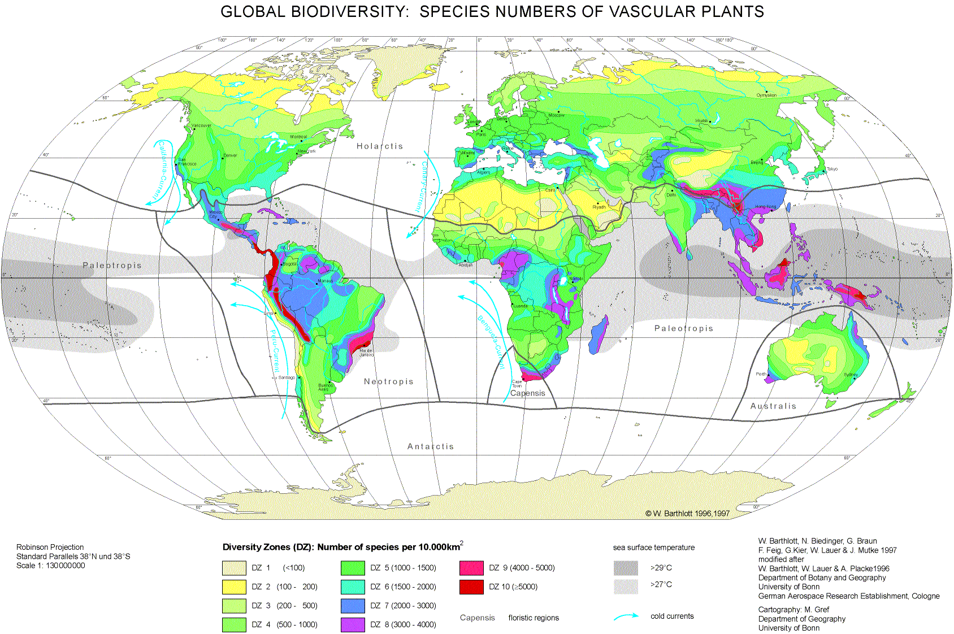
Is Biodiversity constant?
Worldwide: Biodiversity “Hotspots”

Slide 5
Is Biodiversity constant?
Worldwide: Biodiversity “Hotspots”
“Latitudinal Diversity Gradient”
Regionally: Land Use Differences

Slide 6
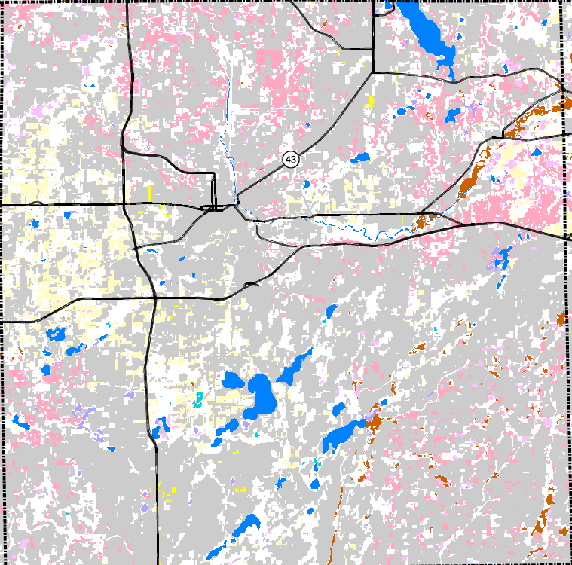
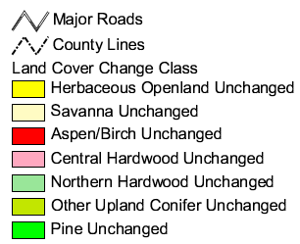
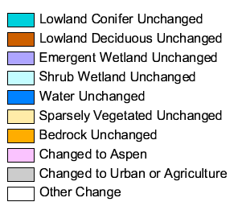

Slide 7
Is Biodiversity constant?
Worldwide: Biodiversity “Hotspots”
“Latitudinal Diversity Gradient”
Regionally: Land Use Differences
Habitat destruction
Biodiversity is declining!
30% of species extinct by 2050

Slide 8
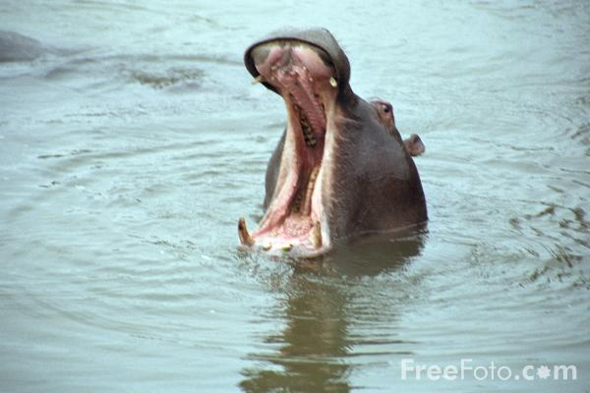
HIPPO
habitat destruction
invasive species
pollution
human over population
over-harvesting

Slide 9
Exploring Biodiversity:
Biodiversity Stock Market!

Slide 10
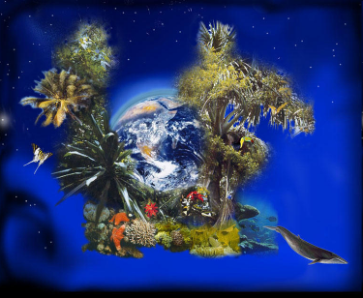
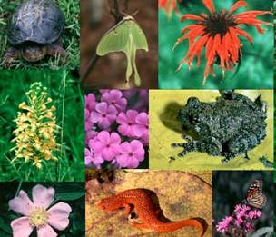
Why Is Biodiversity Important?
May help increase ecosystem productivity
The more species you have the more completely you can use the land’s resources
Certain species may help or allow other species to grow

Slide 11
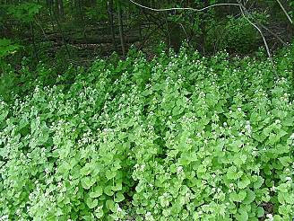
Why Is Biodiversity Important?
May help ecosystem stability
More resistant to invasion
More resistant to disease
More resilient toward disturbances

Slide 12
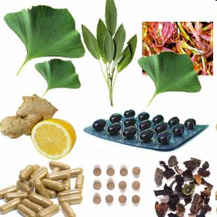
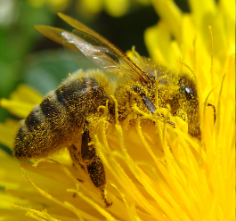
Ecosystem Services
Food, water, energy
Purify air and water
Potential medicines
Ecotourism
Seed dispersal
Pollination

Slide 13
Ecosystem Services
The economic value of all ecosystem services is estimated to be ~$3 trillion per year

