Slide 1
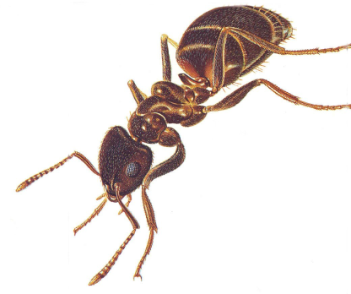
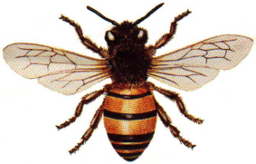
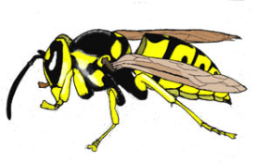
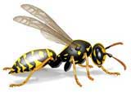
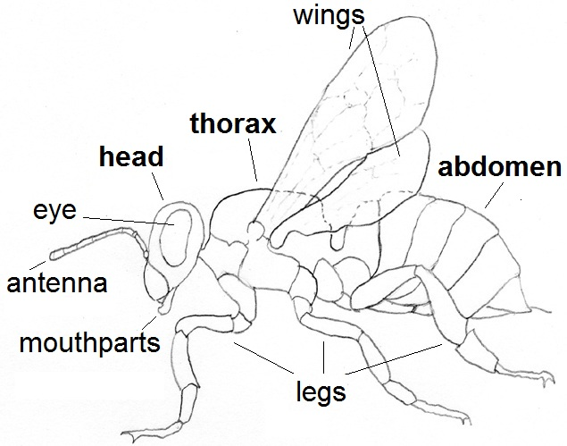
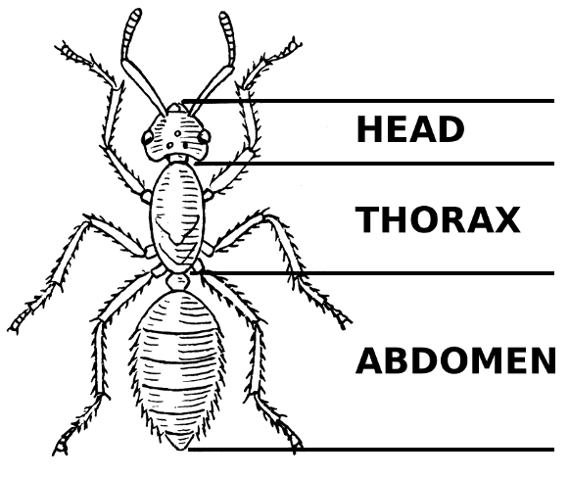
ants, bees, wasps
body length size range: 0.2-3.0cm
hymenoptera
insecta
Anatomy
Food
Habitat
have 3 body sections
(head, thorax, abdomen),
6 legs, hard exoskeleton, most have 1 or 2
pairs of wings
eat almost any organism, living or dead, including fungi, plants, and animals; some are specialists, ex: bees specialize on
pollen and nectar
live on land
in nearly every
kind of habitat

Slide 2
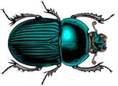
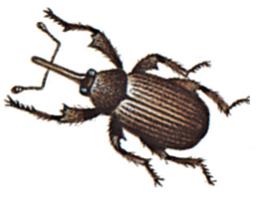
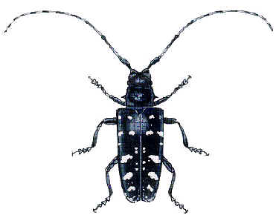
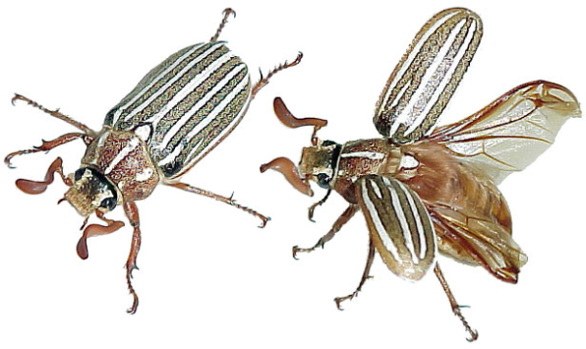
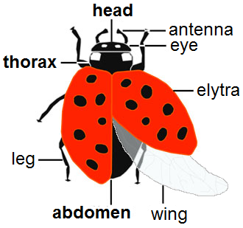
beetles & weevils
body length size range: 0.05-20cm
coleoptera
insecta
Anatomy
Food
Habitat
have 3 body sections
(head, thorax, abdomen),
6 legs, hard exoskeleton, hard coverings over wings (elytra)
can eat almost any organism, living or dead,
including fungus, plants,
and animals
live on land
in nearly every
kind of habitat

Slide 3
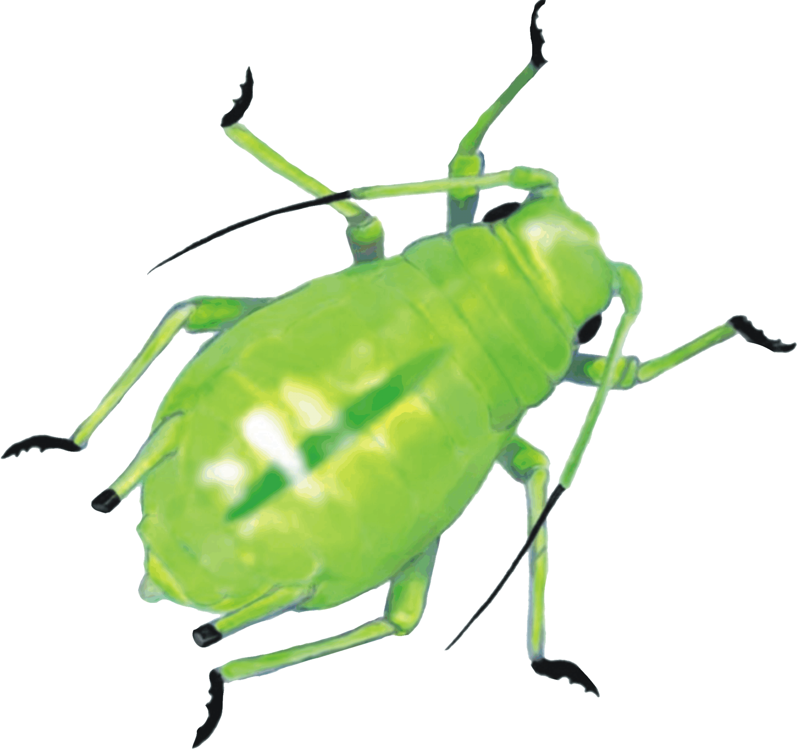
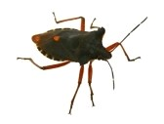
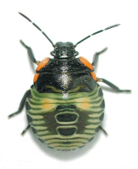
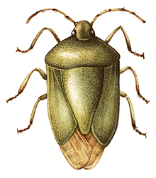
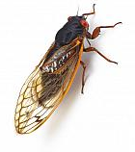
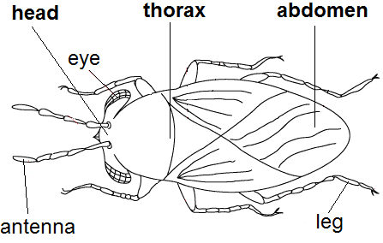
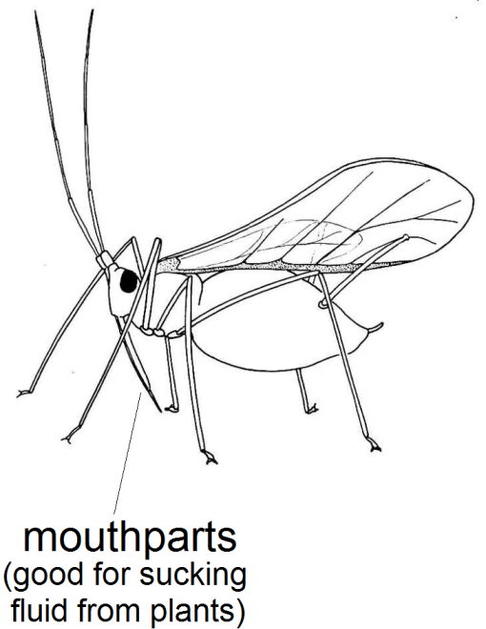
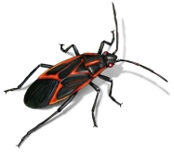
true bugs, cicadas, aphids
body length size range: 0.1-2.0cm
hemiptera
insecta
Anatomy
Food
Habitat
have 3 body sections
(head, thorax, abdomen),
6 legs, a hard exoskeleton,
1 or 2 pairs of wings
especially good at sucking fluid from plants
or other insects
live on land
in nearly every
kind of habitat

Slide 4
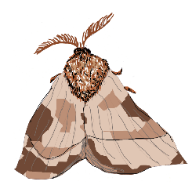
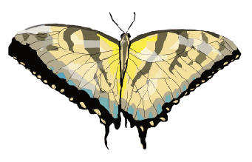
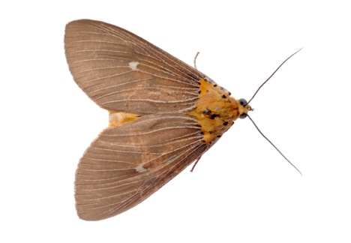
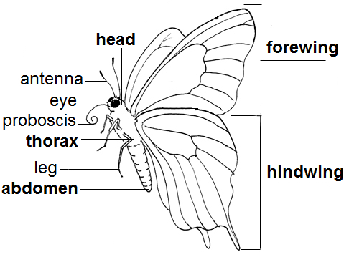
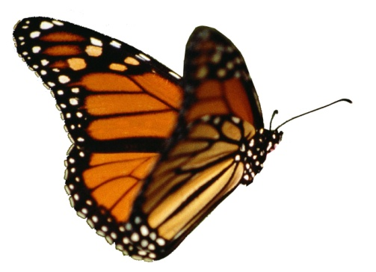
butterflies & moths
body length size range: 0.4-30cm
lepidoptera
insecta
Anatomy
Food
Habitat
have 3 body sections
(head, thorax, abdomen),
6 legs, an exoskeleton,
2 pairs of wings
feed on plants, including pollen, nectar and leaves
live on land
in nearly every
kind of habitat,
some species migrate long distances

Slide 5
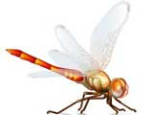
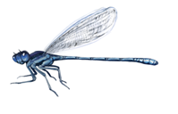
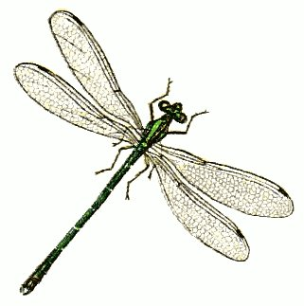
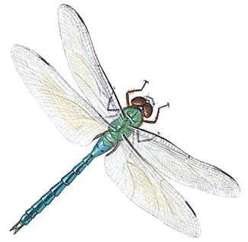
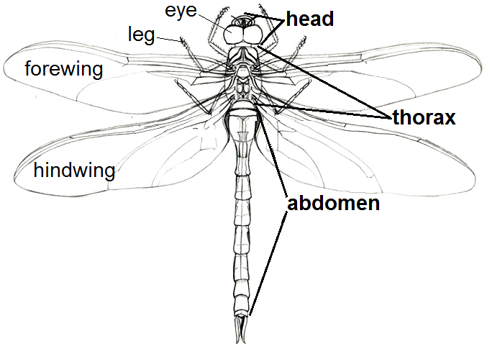
dragonflies & damselflies
body length size range: 1.5-12cm
odonata
insecta
Anatomy
Food
Habitat
have 3 body sections
(head, thorax, abdomen),
6 legs, an exoskeleton,
2 pairs of wings
feed on other insects
live on land,
often found near water because larvae live in water before metamorphosis

Slide 6
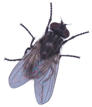
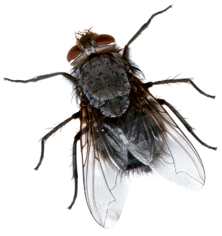
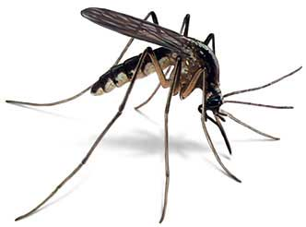
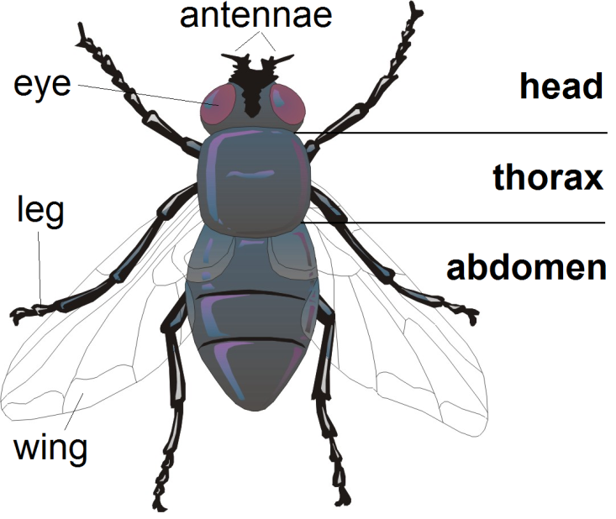
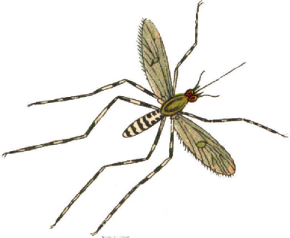
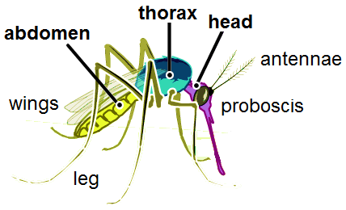
flies & mosquitoes
body length size range: 0.5-1.5cm
diptera
“diptera” means two wings
“di” means two
and
“ptera” means wings
insecta
Anatomy
Food
Habitat
have 3 body sections
(head, thorax, abdomen),
6 legs, an exoskeleton,
1 pair of wings
mouthparts good at sucking fluids from plants and animals
live on land, mosquitoes require water for eggs and larvae to develop, flies deposit eggs on food source, ex: rotting food

Slide 7
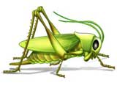
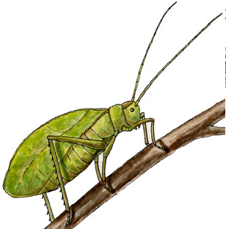
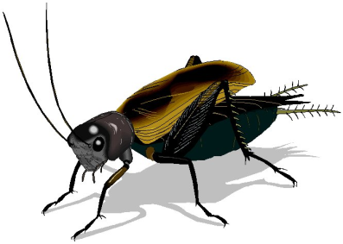
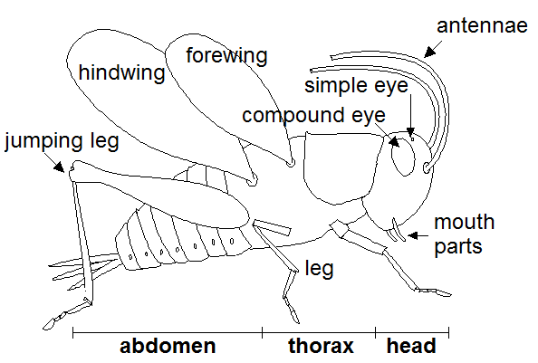
grasshoppers, katydids, crickets
body length size range: 0.2-10cm
orthoptera
insecta
Anatomy
Food
Habitat
have 3 body sections
(head, thorax, abdomen),
6 legs, an exoskeleton,
2 pairs of wings
can eat almost any organism, living or dead,
including fungus, plants, animals, and especially other insects
live on land
in nearly every
kind of habitat

Slide 8
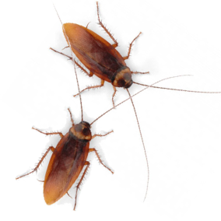
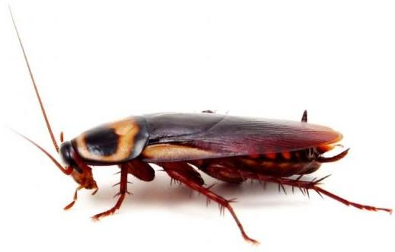
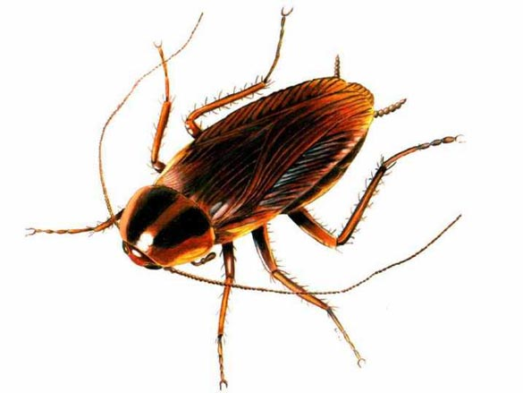
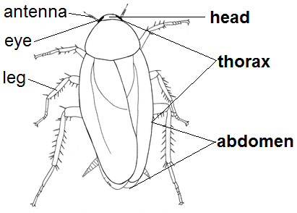
cockroaches
body length size range: 1.5-9.0cm
blattodea
insecta
Anatomy
Food
Habitat
have 3 body sections
(head, thorax, abdomen),
6 legs, an exoskeleton,
2 pairs of wings
scavengers,
will eat almost any organism, living or dead,
including fungus, plants, animals
live on land
in nearly every kind of habitat, often found near human developments

Slide 9
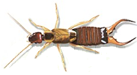
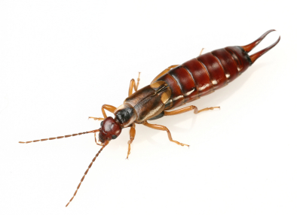
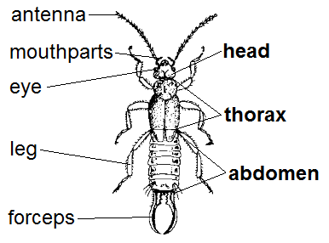
earwigs
body length size range: 0.6-3.5cm not including forceps
dermaptera
insecta
Anatomy
Food
Habitat
have 3 body sections
(head, thorax, abdomen),
6 legs, an exoskeleton,
2 pairs of wings
but rarely fly
eat almost any organism, living or dead,
typically eat plants and other insects,
common crop pest
occur in North America, Europe, and Australia in a variety of habitats

Slide 10
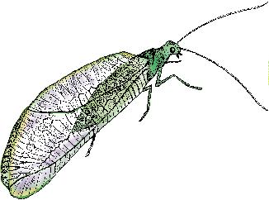
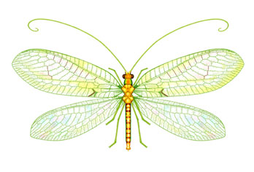
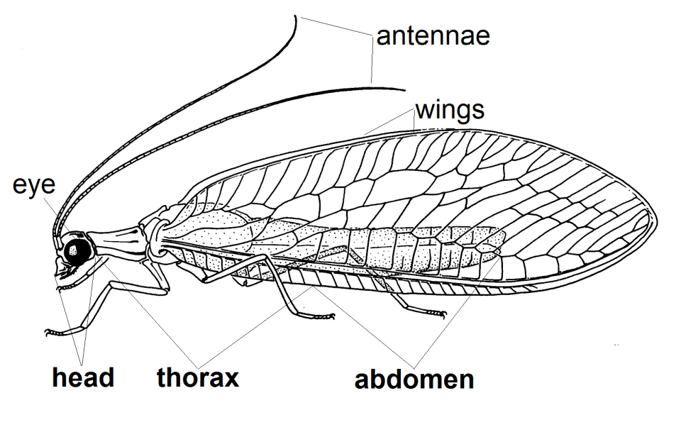
lacewings
body length size range: 1-5cm
neuroptera
insecta
Anatomy
Food
Habitat
have 3 body sections
(head, thorax, abdomen),
6 legs, an exoskeleton,
2 pairs of wings
can eat almost any organism, living or dead,
including fungus, plants, animals, and especially other insects
live on land
in nearly every
kind of habitat

Slide 11
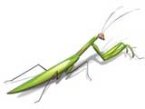
praying mantids
body length size range: 2-15cm or larger
mentodea
insecta
Anatomy
Food
Habitat
have 3 body sections
(head, thorax, abdomen),
6 legs, an exoskeleton,
2 pairs of wings
eat primarily other insects; some species also eat
small animals, such as snakes, birds, rodents,
fish, and lizards!
live on land
in habitats with
lots of plants
and mild winters

Slide 12
termites
body length size range: 0.5-2.5cm
isoptera
insecta
Anatomy
Food
Habitat
have 3 body sections
(head, thorax, abdomen),
6 legs, an exoskeleton,
some have 2 pairs of wings
eat soil, wood, and grass
live on land
in a variety of habitats

Slide 13
walking sticks
body length size range: 1.2-33cm
phasmida
insecta
Anatomy
Food
Habitat
have 3 body sections
(head, thorax, abdomen),
6 legs, an exoskeleton,
some species have
1 pair of wings
feed mostly on leaves of trees and bushes
live on land
in a variety of habitats
with plants

Slide 14
springtails
body length size range: 0.6cm or less
collembola
insecta
“tail” usually folded under body and used
to jump when threatened
Anatomy
Food
Habitat
have 3 body sections
(head, thorax, abdomen),
6 legs, an exoskeleton,
some species have
1 pair of wings
eat plants, living or dead,
sometimes considered
a pest for crops
live on land
in a variety of habitats
with moisture and leaf litter or other rotting material

Slide 15
mayflies
body length size range: 10-20cm with tails
ephemeroptera
insecta
Anatomy
Food
Habitat
have 3 body sections
(head, thorax, abdomen),
6 legs, an exoskeleton,
2 pairs of wings
larvae feed mostly on
algae and plankton
adults live only 30 minutes to 24 hours to reproduce and do not eat
live on land,
found near water because larvae live in water before metamorphosis

Slide 16
scorpionflies
body length size range: 0.5-2.0cm
mecoptera
insecta
Anatomy
Food
Habitat
have 3 body sections
(head, thorax, abdomen),
6 legs, an exoskeleton,
2 pairs of wings
eat almost any organism, living or dead, including fungus, plants, and animals
live on land,
in cool, moist habitats

Slide 17
caddisflies
body length size range: 0.15-4.0cm
thrichoptera
insecta
Anatomy
Food
Habitat
have 3 body sections
(head, thorax, abdomen),
6 legs, an exoskeleton,
2 pairs of wings
larvae eat animals and plants living in the water,
adults are short-lived
and rarely eat
live on land,
found near water because larvae live in water before metamorphosis

Slide 18
spiders, ticks, daddy long legs
body length size range: 0.1-30cm
arachnida
Anatomy
Food
Habitat
have 2 body sections
(cephalothorax & abdomen),
8 legs, an exoskeleton
attack small animals, especially insects and other arachnids and feed on their blood and fluids
live on land
in nearly every
kind of habitat,
some even live in freshwater

Slide 19
centipedes
body length size range: 0.2-30cm
chilopoda
Anatomy
Food
Habitat
have large antennae, 1 pair of legs per body segment, the last pair of legs extends behind the body
attack smaller animals,
such as worms and insects,
kill prey with venom,
some feed on plants, too
live on land
in damp areas such as leaf litter, under logs or rocks

Slide 20
millipedes
body length size range: 0.2-28cm
diplopoda
Anatomy
Food
Habitat
the front 3 body segments have 1 pair of legs each, the rest of the body segments have 2 pairs of legs each
eat mostly rotting plant material, some species eat other small animals
live on land
in moist areas under rocks, rotting logs, and leaves

Slide 21
earthworms
body length size range: 0.5-670cm
clitellata
Anatomy
Food
Habitat
have a segmented, tube-like muscular body, can have 37 to 100 body segments
eat dead leaves and
small soil particles
live on land and in freshwater and oceans, usually live in the soil

Slide 22
snails & slugs
body length size range: 0.3-90cm
gastropoda
Anatomy
Food
Habitat
have eyes on stalks that can extend or be pulled into the head, snails have a shell,
slugs do not have a shell
eat both living and dead plants, some snail species also eat earthworms or other snails
live on land and in freshwater and oceans

Slide 23
pillbugs
body length size range: 0.5-1.5cm
malacostraca
Often mistaken as insects,
pillbugs are actually crustaceans
like crabs and lobsters.
Anatomy
Food
Habitat
have a head, thorax, and abdomen each made up of
5 to 8 segments
eat live or dead
plants, animals, and fungus
live on land in
damp, dark areas, such as under rocks or rotting logs, sometimes found in people’s basements

