Slide 1
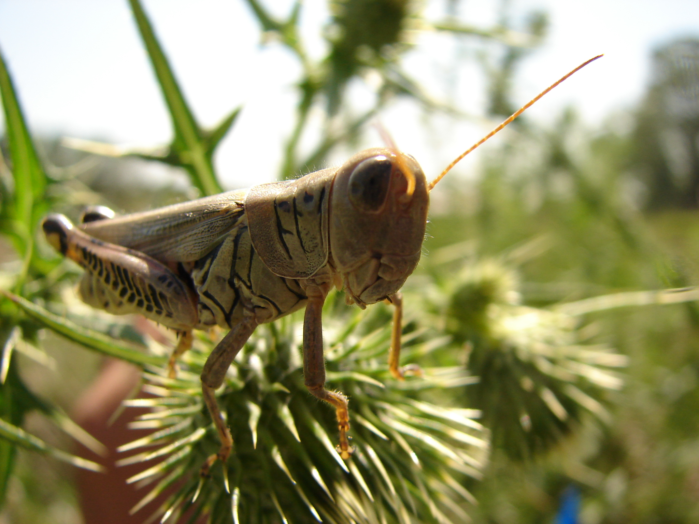
The Scientific Method
Insect Biodiversity
Ms. Schultheis
Notes:
Everyone who asks a question or wonders why something happens is acting as a scientist. Scientists are curious people who are always wanting to know about the things around them and why things occur the way they do. Scientists seek to answer questions by following a simple, logical, and straightforward prescription which we call the scientific method. Scientists observe the world around them and produce explanations of why an event occurs. Their explanation, or hypothesis, is then tested, and refined until it is always true so that it can become a scientific law.

Slide 2
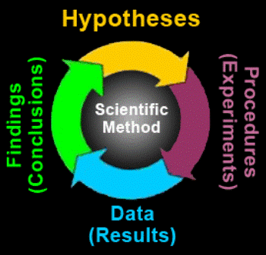

Slide 3
Hypothesis
A possible explanation for something we observe around us
Addresses a particular question we have

Slide 4
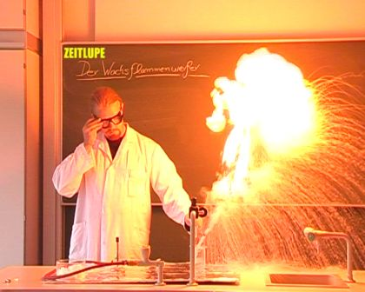
Experiment
Design an experiment that will test your hypothesis
Procedure you choose must take into account other factors that might interfere with your results
Results must be reliable

Slide 5
In your experiment you must:
Replicate
Randomize
Reduces bias of the scientist
Gives a more reliable sample

Slide 6
Collect and interpret data
Data – the observations and measurements taken while running the experiment
Make graphs
Draw tables
Make calculations
Check for
sources of error

Slide 7
Draw conclusions and design future experiments!
Does your data support your original hypothesis?
What do the conclusions of your study mean for science and society?
Is there something you would change about the previous experiment?
Does the experiment lead to even more questions?

Slide 8
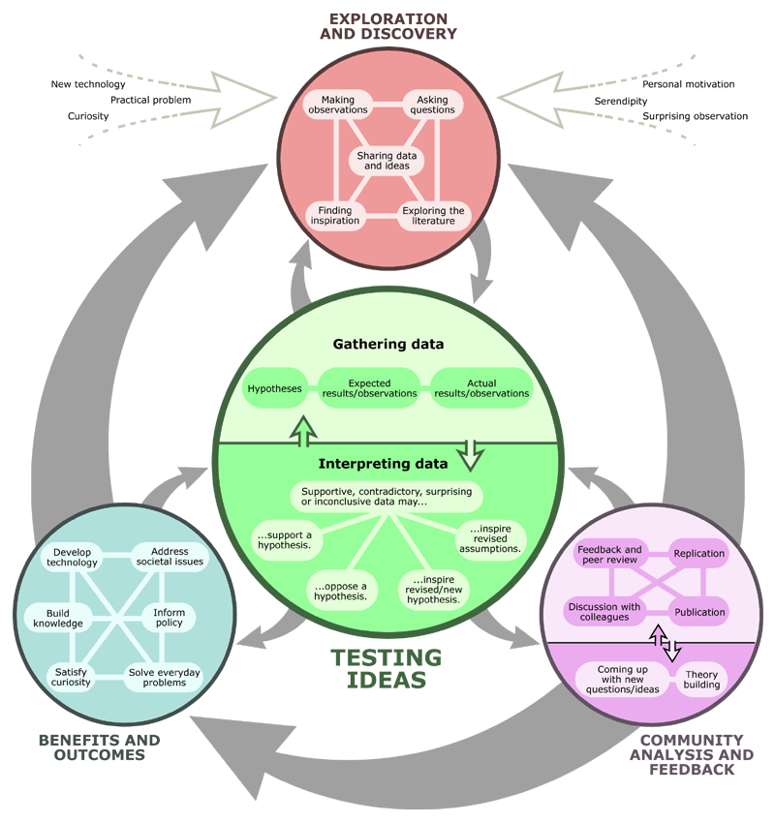

Slide 9
What habitats have the highest insect diversity?
Your Scientific Question:

Slide 10
Break into groups to discuss:
What hypothesis do you want to test related to the scientific question?
How will you test your hypothesis?
Write down:
Your hypothesis
A short experimental design

Slide 11
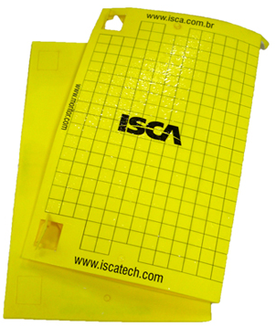
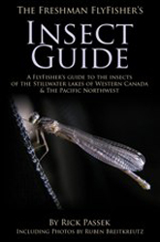
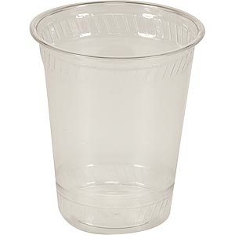
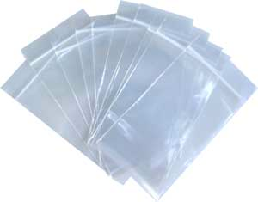
Your supplies:
Habitats around your school:
Bioenergy plots
Lawn
Parking lot

Slide 12
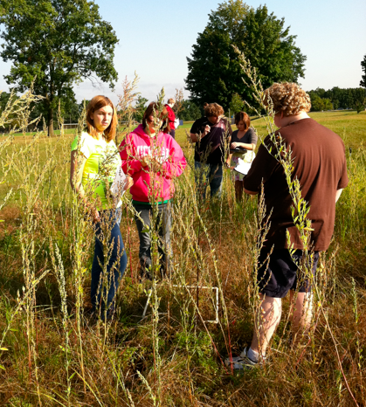
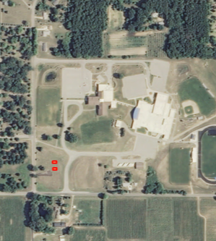
Go into the field!
Bioenergy Plots
School Yard

Slide 13
Pooled class data

Slide 14
Pooled class data
10
11
16
6
468
948
512
130
10
7
9
2
46.8
86.2
32
8.1
1
0.6
1.8
0.125
Notes:
Data from Lawton School District – High School, Holly Visich

Slide 15
Invertebrate Abundance
Notes:
Data from Lawton School District – High School, Holly Visich

Slide 16
Invertebrate Kinds
Notes:
Data from Lawton School District – High School, Holly Visich

