Slide 1
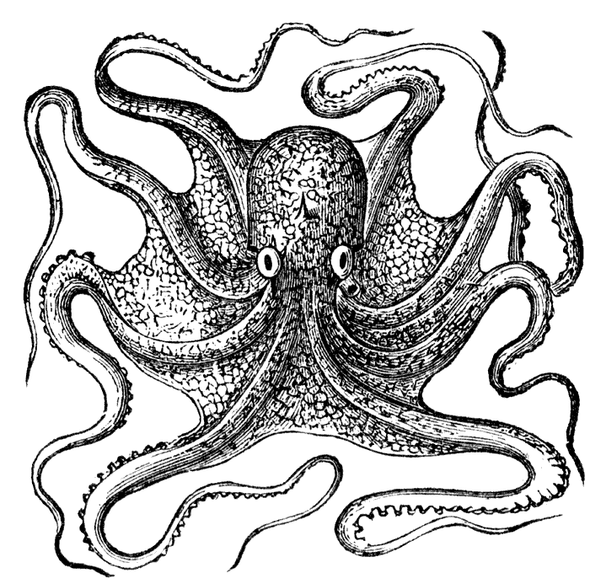
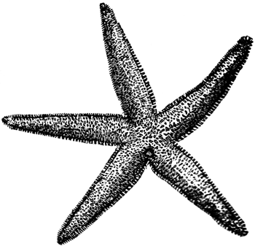
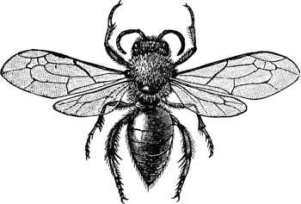
Incredible Invertebrates!
Alycia Reynolds Lackey
& Kate Steensma
etc.usf.edu

Slide 2
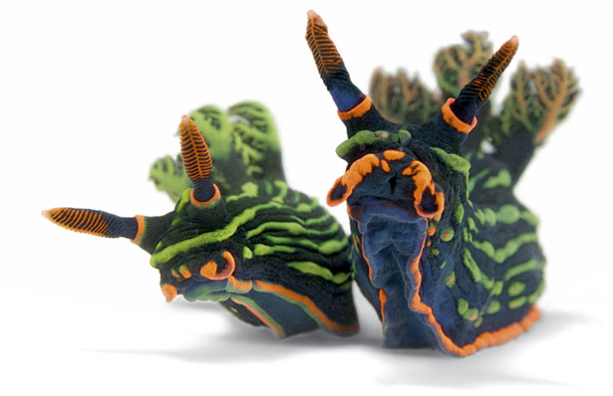
in·ver·te·brate /inˈvərtəbrit/
Noun: an animal lacking both a skull and a backbone such as an arthropod, mollusk, annelid, etc.
Invertebrates include between 95-97% of all animal species
ngm.nationalgeographic.com

Slide 3
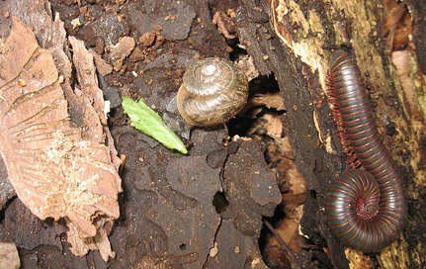
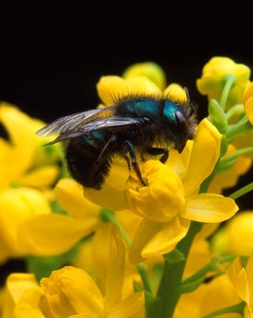
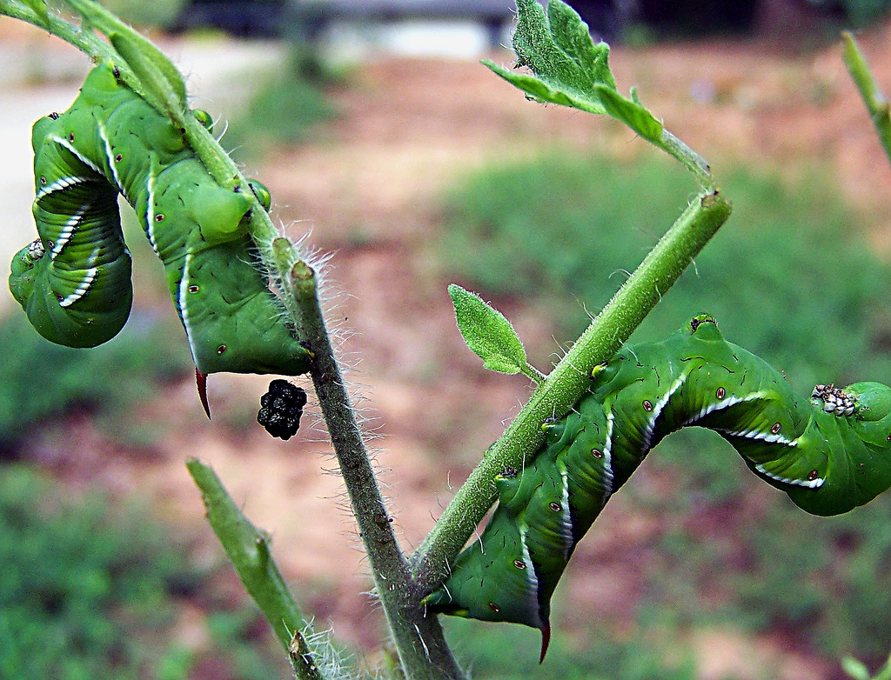
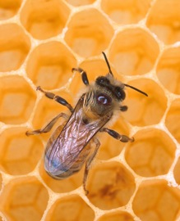
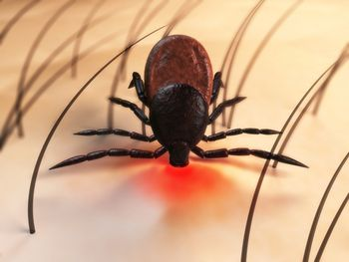
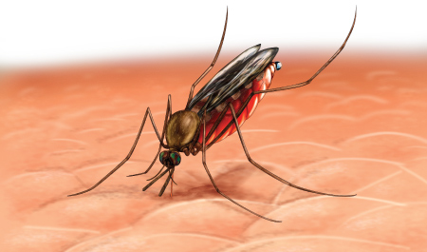
Impact on humans
Crop destroyers
Decomposers
Pollinators
Disease vectors
Clam chowders
Honey makers
newasiancuisine.com, wikipedia.org, malaria-symptoms.org

Slide 4
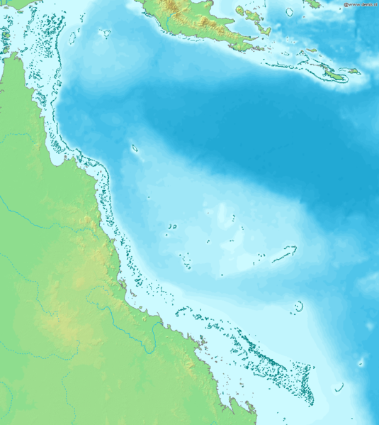
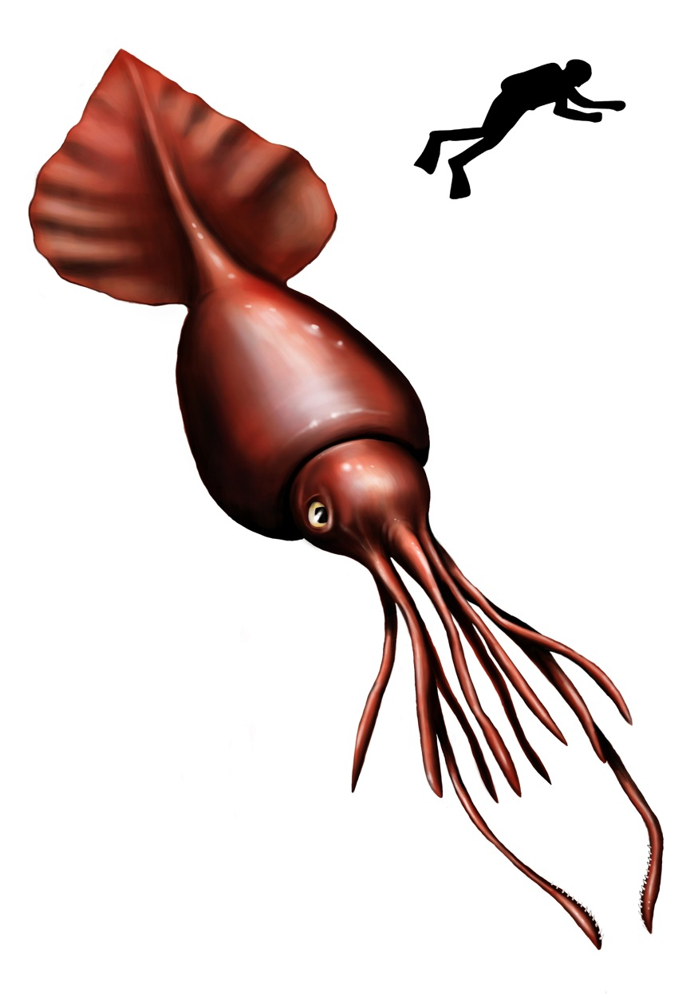
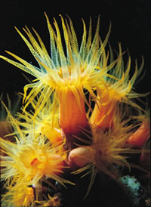
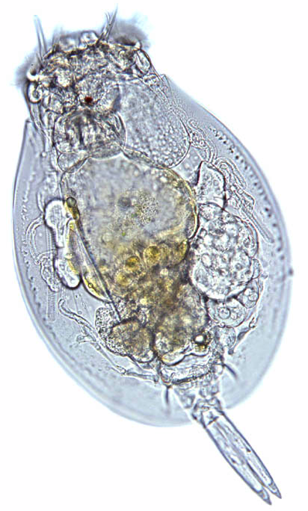
Notable invertebrates
Coral polyp:
~1-3 mm
Largest invertebrate:
Colossal Squid
~39-46 feet long
Smallest invertebrate:
Rotifer
~0.1-0.5 mm
Largest invertebrate colony:
Great barrier reef
Over 1,600 miles long
wikipedia.org, microscopy-uk.org.uk

Slide 5
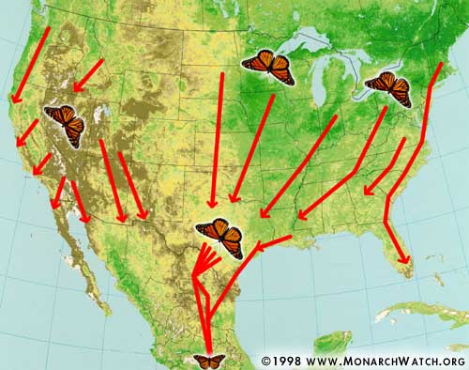
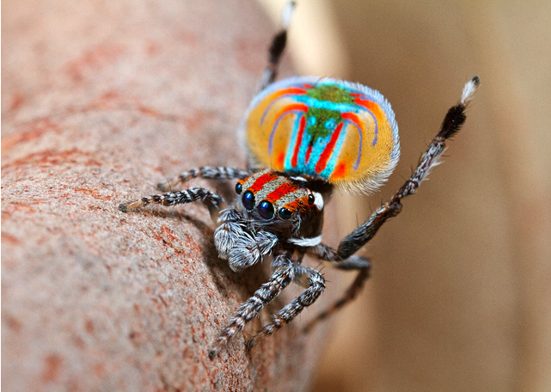
Notable invertebrates
Mass migration:
Monarch butterfly
Sometimes travels up to 3,000 miles
Performer:
Australian peacock spider
Woos his mate with an elaborate dance
monarchwatch.org, Jurgen Otto on flickr.com

Slide 6
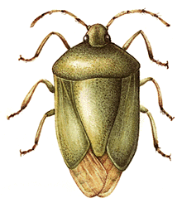
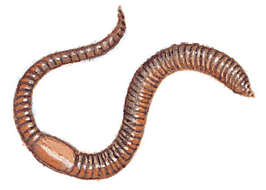
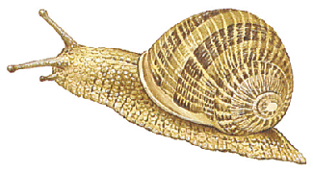
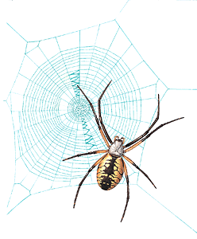
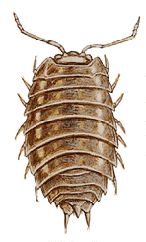
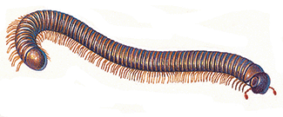
Michigan invertebrates
Michigan has about ~20,000 species of invertebrates, including:
0 legs
0 legs
6 legs
Annelids
Mollusks
Insects
10-14 legs
8 legs
20+ legs
Arachnids
Myriapods
Crustaceans
animals.howstuffworks.com

Slide 7
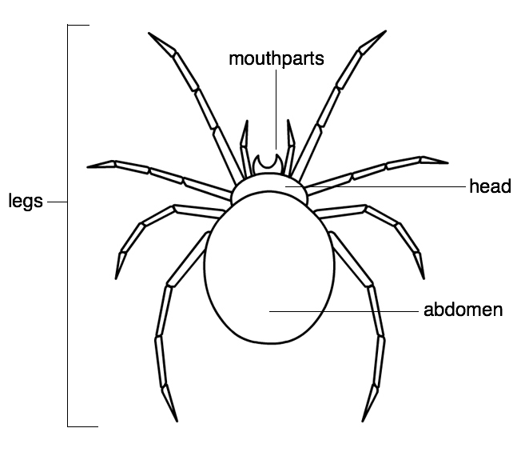
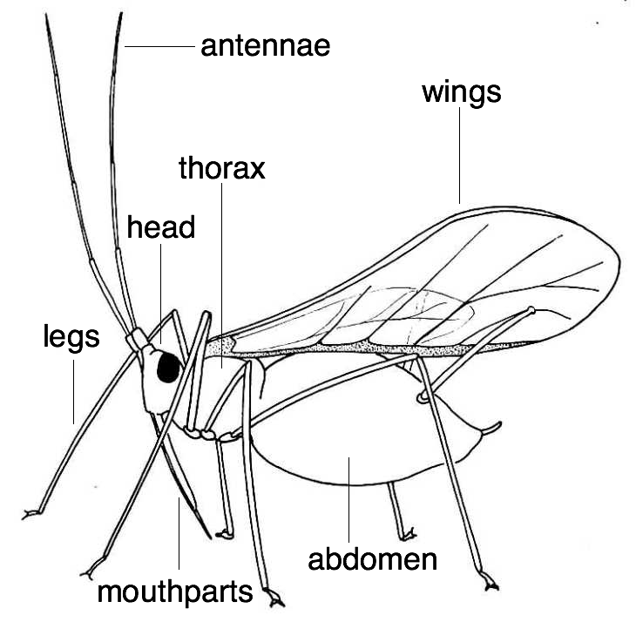
Basic anatomy
Arachnids
(spiders & ticks):
-8 legs
-2 body segments
-no antennae
Insects:
-6 legs
-3 body segments
-antennae
-wings (sometimes)

Slide 8
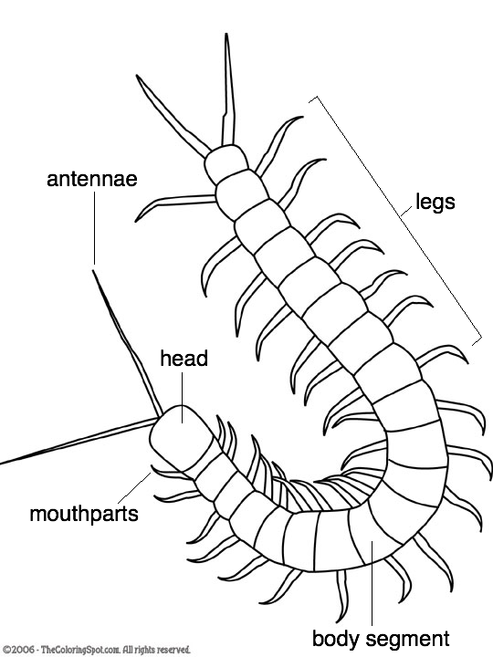
Basic anatomy
Crustaceans
(pillbugs and sowbugs):
-10-14 legs
-many body segments
-antennae
Myriapods
(centi- & millipedes):
-20+ legs
-many body segments
-antennae

Slide 9
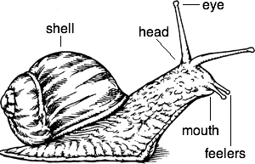
Basic anatomy
Annelids (segmented worms):
-no legs
-many body segments
-no antennae
Mollusks
(slugs, snails):
-no legs
-no body segments
-feelers (not antennae)
-shell (sometimes)

