Slide 1
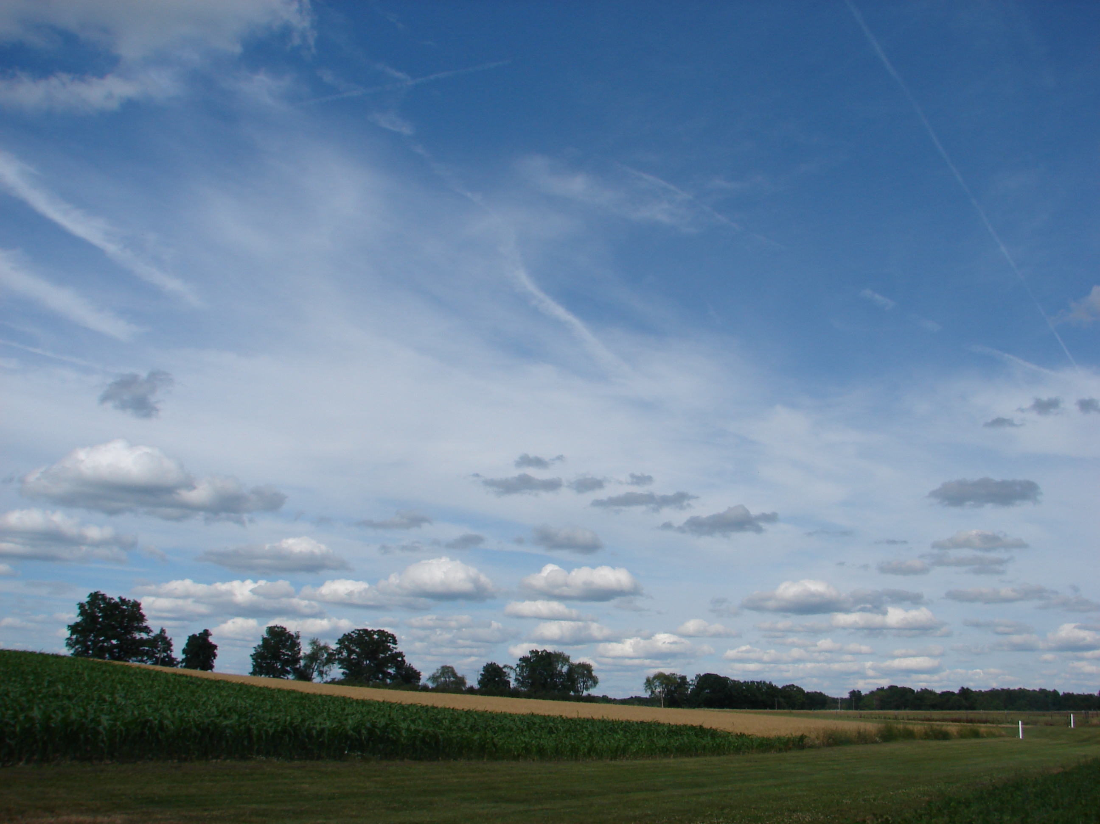
Exploring of plant-rhizobia interactions

Slide 2
Ouline
Brief background
Experimental design
Scientific methods
Setting up an experiment!

Slide 3
Scientific Methods
Observation
Background Research
Question
Hypothesis/Predictions
Experiment
Answer?
Not consistent with hypothesis
Data analysis
Consistent with hypothesis
Conclusion

Slide 4
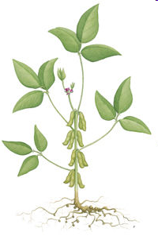
Background
What happens when you add N in the system?
Soybean
CO₂+H₂O +light
C₆H₁₂O₆+O₂
N₂
NH₃
Photosynthesis
Nitrogen Fixation
Rhizobia
Notes:
Ask:
Why do plants need Nitrogen?
Biological molecules that contain nitrogen:
Proteins
Nucleic acids

Slide 5
Fertilizer in agriculture
Background
“….addition of N fertilizer can lead to lower production of nodules in legumes (Rubio Arias et al. 1999; Vargas, Mendes &Hungeria 2000) as well as lower N₂fixation rates per nodule (Denison & Harter 1995).”

Slide 6
Today’s Question:
Questions
How do rhizobia affect plant growth?
How does nitrogen fertilization affect plant-rhizobia interaction?

Slide 7
Hypotheses
Hypotheses
An educated answer to the question posed
How do rhizobia affect plant growth?
2) How does nitrogen fertilization affect plant-rhizobia interaction?
H1: Rhizobia has a positive effects on plant growth
H2: N fertilization reduces the strength of interaction

Slide 8
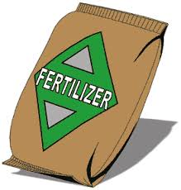
1) How do rhizobia affect plant growth? How can we test it?
Experiment
+
+
Control
Treatment 1
Treatment2
The control and experimental groups must be identical in all relevant ways except for the introduction of a suspected causal agent into the experimental group.

Slide 9
What else do we need?
Experiment
Replication
+
+
Repetition of a experiment to test the validity of its conclusion
+
+
+
+
+
+
+
+

Slide 10
What else??
Experiment
Randomization
+
+
-Assign treatment randomly to an experimental group
-Eliminate researchers’ bias or judgment
+
+
+
+
+
+
+
+

Slide 11
Prediction
Prediction
Plot a prediction graph on your worksheet
???
Plant Size
Control
Rhiz (+)
Nitrogen (+)
+
+

Slide 12
2) How does nitrogen fertilization affect plant-rhizobia interaction?
Experiment
+
+
+

Slide 13
Predictions:
Predictions
Plot prediction graphs on your worksheet
Plant Size
# Nodules
N (-)
N (+)
N (-)
N (+)

Slide 14
Experimental Design Combining Experiment 1&2
Experiment
n = 10
n = 10
Exp 1
n = 10
n = 10
Exp 2
Each group: 4 treatments x 2 rep = 8 samples
Class total = 40

Slide 15
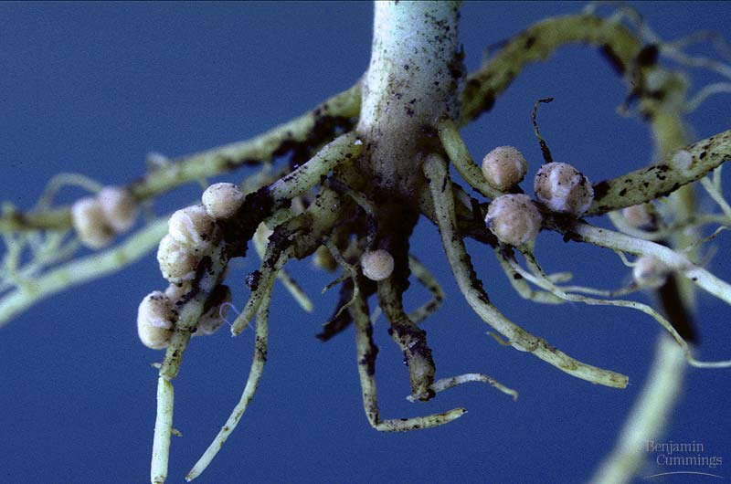
After 1 month….
Record:
Plant height (cm)
Number of leaves
Number of nodules
Aboveground biomass
Belowground biomass
3) Plot graphs using the class data
Notes:
-ruler
-balance (sensitive one)
-tray
-bucket for soil
-microcentrifuge tube
-forceps
-paper bag)
-box to collect all the trays and pots
-scissors
-datasheet

Slide 16
Let’s do it!
Each group should prepare 2 replicates for each treatment:
1) 3 seeds
2) 3 seeds + rhizobia
3) 3 seeds + fertilizer
4) 3 seeds +rhizobia +fertilizer
Notes:
Sandy

