Slide 1
Why fly south? How climate change alters the phenology of plants and animals
Dustin Kincaid & Liz Schultheis
KBS GK-12 Fall Workshop 2012

Slide 2
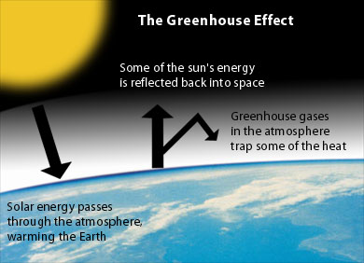
Climate
A period of 30 years is used to determine the climate for an area
Earth’s temperature is regulated by the greenhouse effect: gasses in the atmosphere capture heat before it is radiated back into space
Earth is 60 degrees F warmer because of the greenhouse effect
Notes:
As solar energy streams through the atmosphere on its way to the surface, some is absorbed by gases. All solar energy absorbed by the Earth is eventually radiated back toward space as longwave energy. Some of that outgoing energy is reabsorbed by gases in the atmosphere and then re-emitted back toward the Earth’s surface. This temporarily traps extra energy in the Earth’s atmosphere and increases the Earth’s surface temperature. The importance of this so-called “greenhouse effect” cannot be overstated. Without an atmosphere that acts as a blanket to absorb heat, the Earth would be almost 60 degrees Fahrenheit (F) cooler on average than it is now.

Slide 3
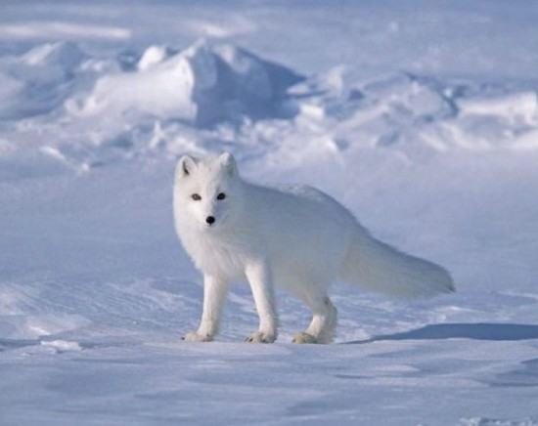
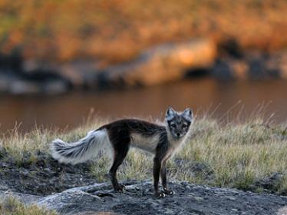
Climate
Plants and animals in an area have adapted to the climate of the past
A period of 30 years is used to determine the climate for an area
Arctic Fox
Notes:
As solar energy streams through the atmosphere on its way to the surface, some is absorbed by gases. All solar energy absorbed by the Earth is eventually radiated back toward space as longwave energy. Some of that outgoing energy is reabsorbed by gases in the atmosphere and then re-emitted back toward the Earth’s surface. This temporarily traps extra energy in the Earth’s atmosphere and increases the Earth’s surface temperature. The importance of this so-called “greenhouse effect” cannot be overstated. Without an atmosphere that acts as a blanket to absorb heat, the Earth would be almost 60 degrees Fahrenheit (F) cooler on average than it is now.

Slide 4
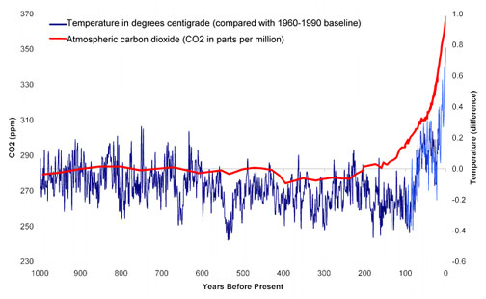
Climate Change
Industrial Revolution
The planet is warming faster than any time in last 10,000 years
CO₂ and other greenhouse gases are at their highest level in 400,000 years
Notes:
Several gases in the Earth’s atmosphere contribute to the greenhouse effect by reabsorbing outgoing longwave heat energy before it escapes into space. Major greenhouse gases are carbon dioxide, nitrous oxide, methane, water vapor, ozone and halocarbons, all of which are naturally occurring except for halocarbons, which were used as coolants, solvents and refrigerants beginning in the 1930s.

Slide 5
Climate Change
CO₂ in the atmosphere has risen 30% since the Industrial Revolution
Climatologists estimate that this change may ultimately result in a 2- to 7-degree F increase in average
Much faster change in climate than previous times in history
What effect will this have on our seasons?
What about the life cycles of plants and animals?

Slide 6
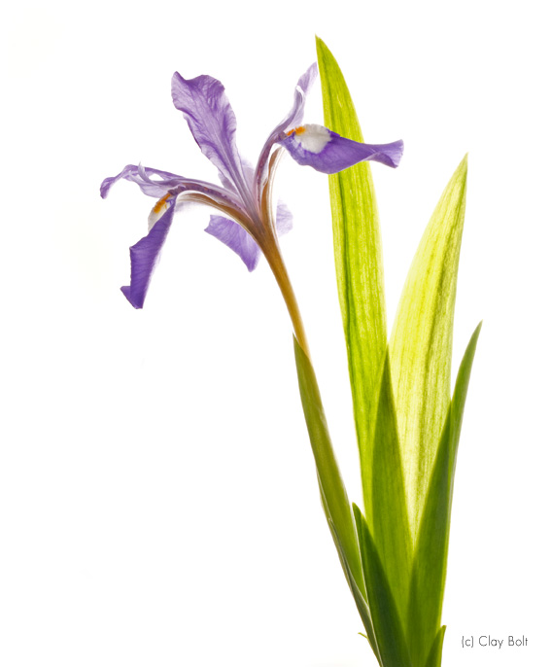
Phenology
Phenology is the study of periodic plant and animal life cycle events and how these are influenced by seasonal and variations in climate
Measure dates of first occurrence of events in annual cycle
ice melt dates for rivers and lakes
date of emergence of leaves and flowers
first flight of butterflies
first appearance of migratory birds
date of coloring in deciduous trees
date of egg laying in birds and amphibians

Slide 7
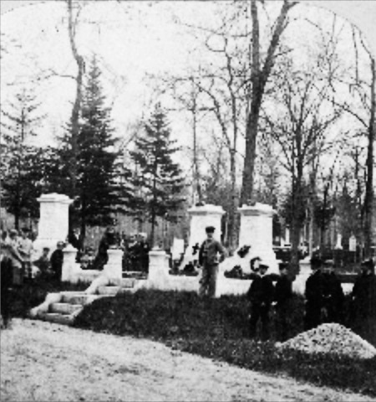
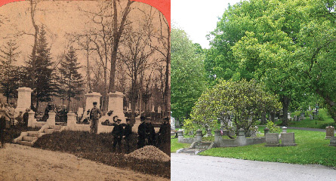
Lowell Cemetery, May 30th
1868 2005
Notes:
Lowell Cemetery is acemetery located in Lowell, Massachusetts. Founded in 1841 [1] and located on the banks of the Concord River, the cemetery is one of the oldest garden cemeteries in the nation,

Slide 8
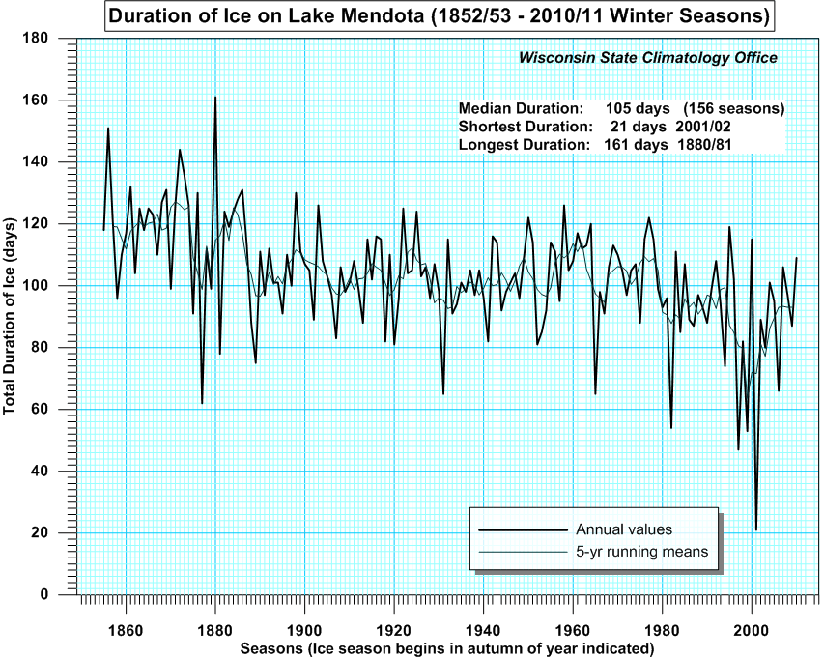
Ice cover on Lake Mendota
Notes:
John Magnuson - Lake Mendota is the northernmost and largest of the four lakes near Madison, Wisconsin. Lake Mendota has been called the most studied lake in the United States

Slide 9
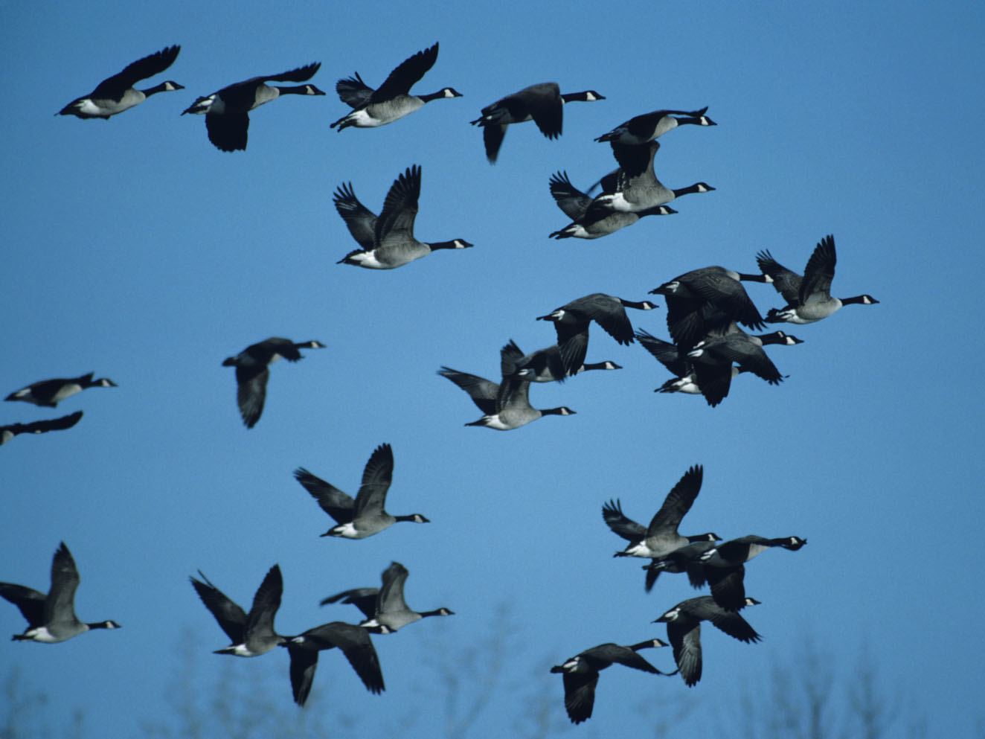
Phenology Mismatch

Slide 10
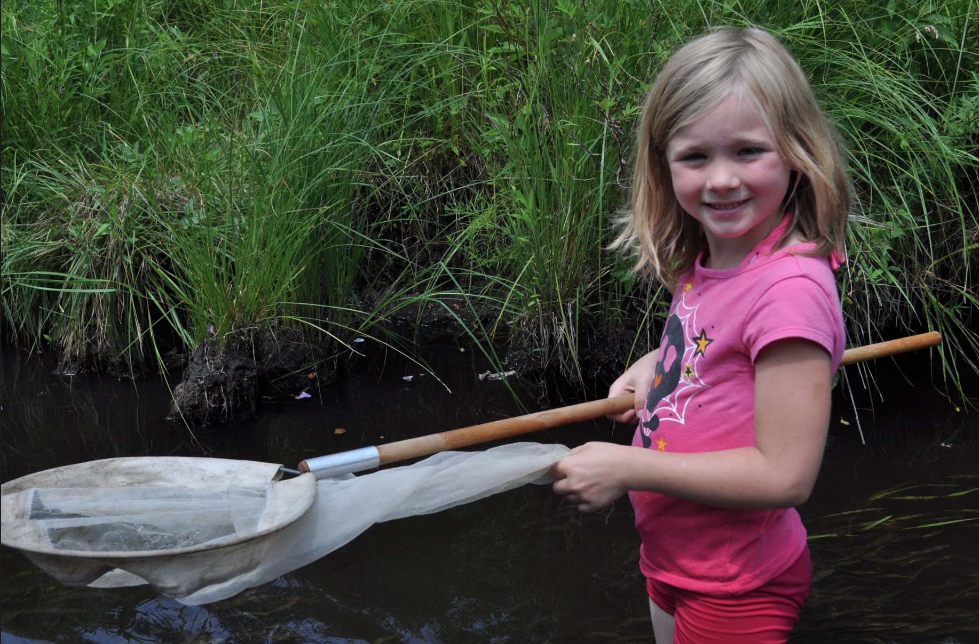
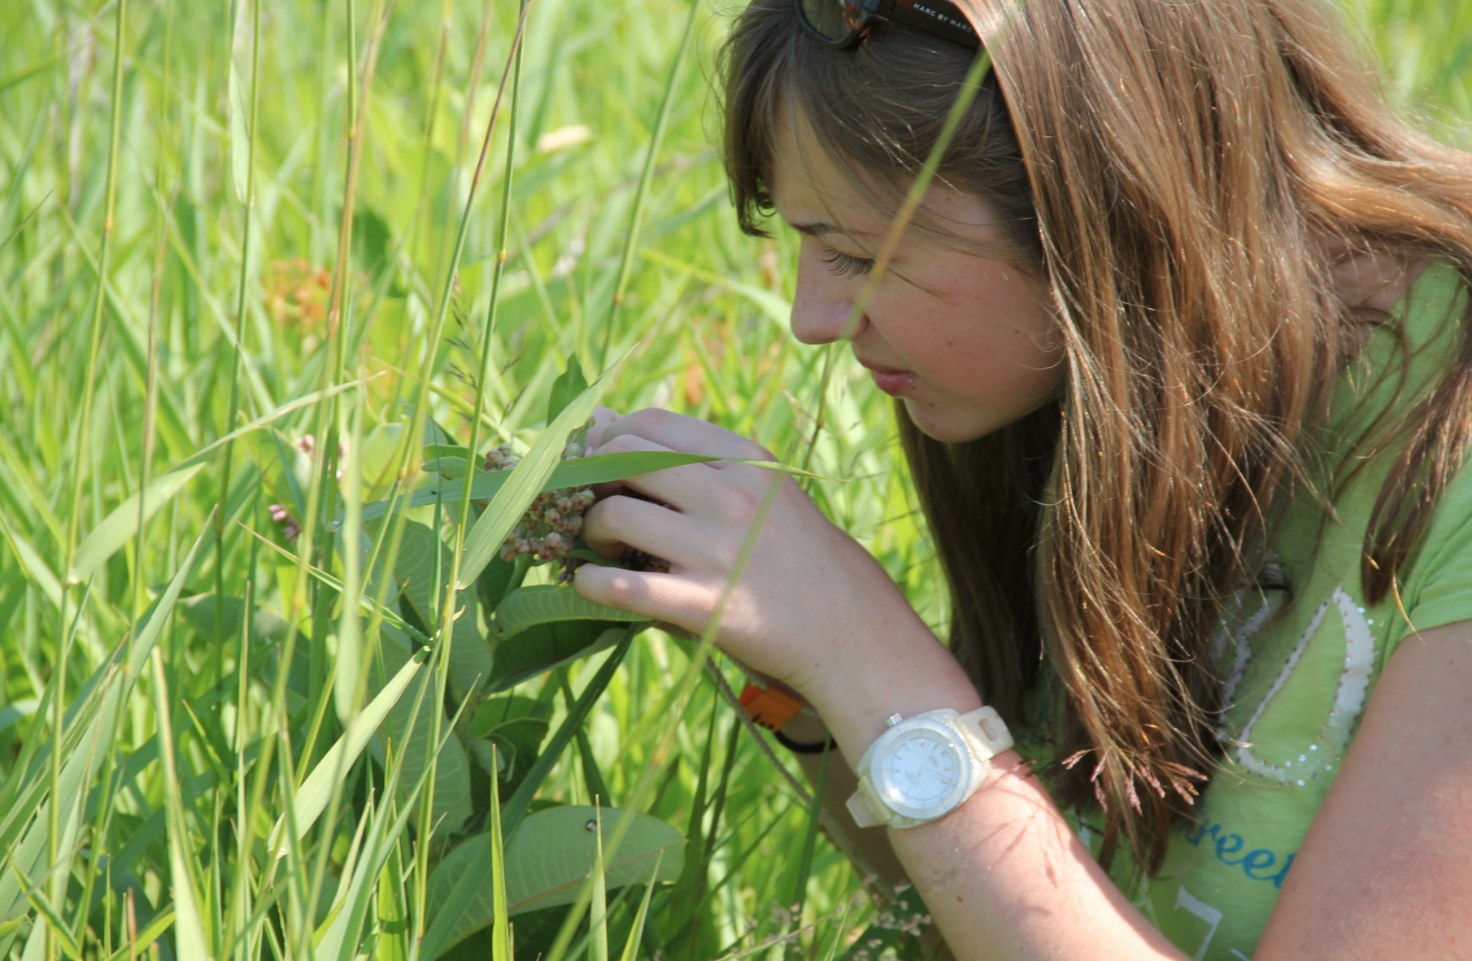
Citizen Science
Research conducted by “crowdsourcing”
Citizen science includes the collection of large amounts of data across large spatial and temporal scales
Phenology data perfectly suited for this:
Need large amounts of data
Easy to observe and measure

Slide 11
Plotting Phenology

Slide 12
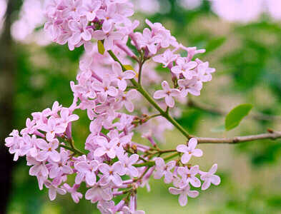
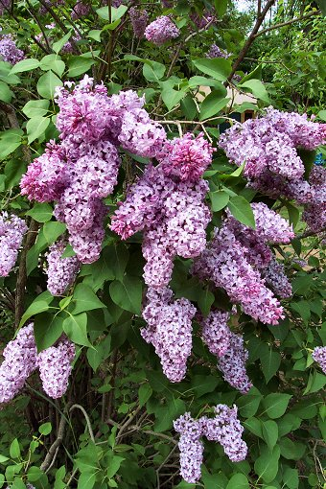
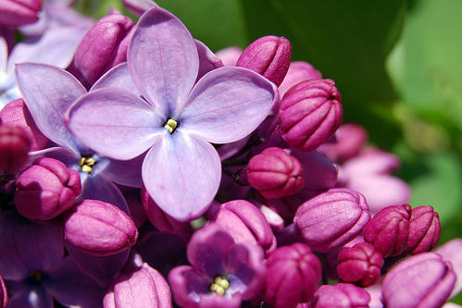

Slide 13
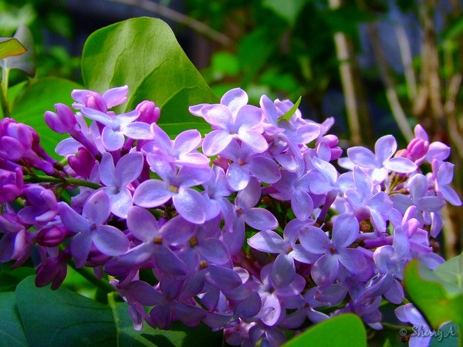
Lilac shrub first bloom date
Lower midwest (Kansas & Nebraska)

Slide 14
Lilac shrub first bloom date
Lower midwest (Kansas & Nebraska)

Slide 15
Lilac shrub first bloom date
Northeast (ME, NH, VT, MA, RI, CT, NY)

Slide 16
Lilac shrub first bloom date
Northeast (ME, NH, VT, MA, RI, CT, NY)

Slide 17
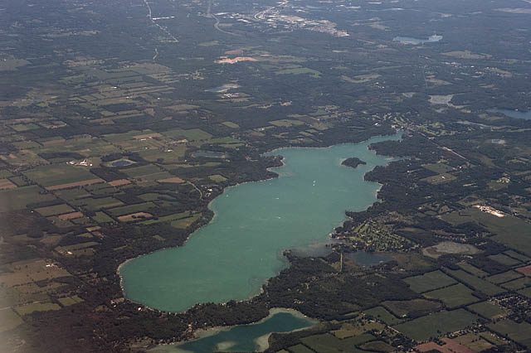
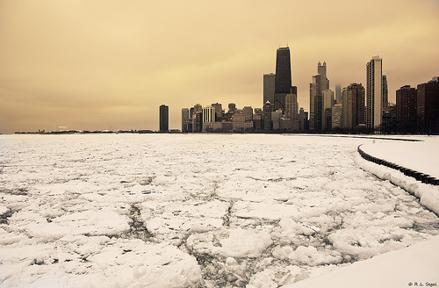
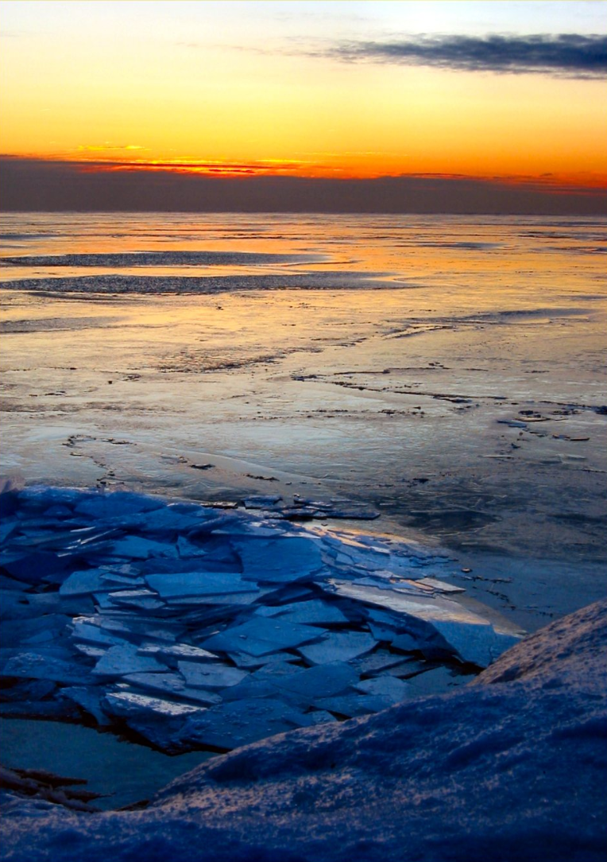
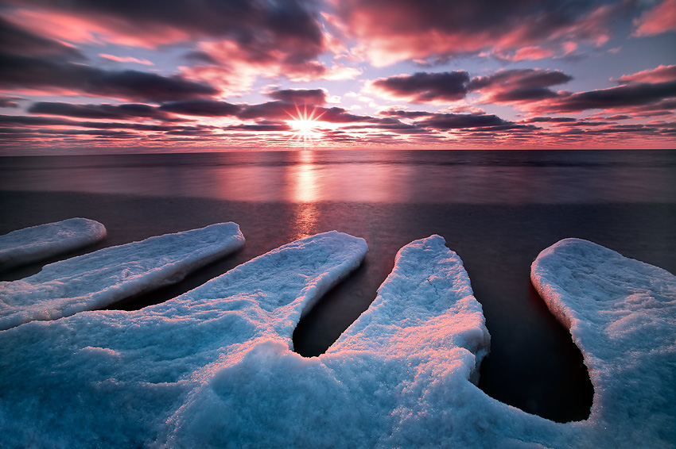

Slide 18
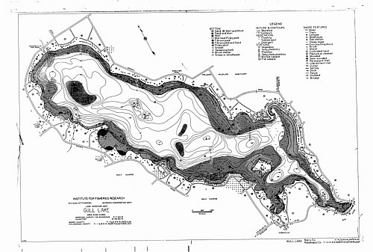
Gull Lake, MI Ice Cover Data

Slide 19
Gull Lake, MI Ice Cover Data

Slide 20
Your Schoolyard!
2012 Future
?
Notes:
What are some easy species that you could measure?

Slide 21
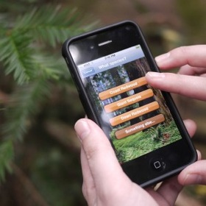
There’s an app for that!
Climate Watch
Ebird
(birdlog)
Project Noah
iNaturalist

Slide 22
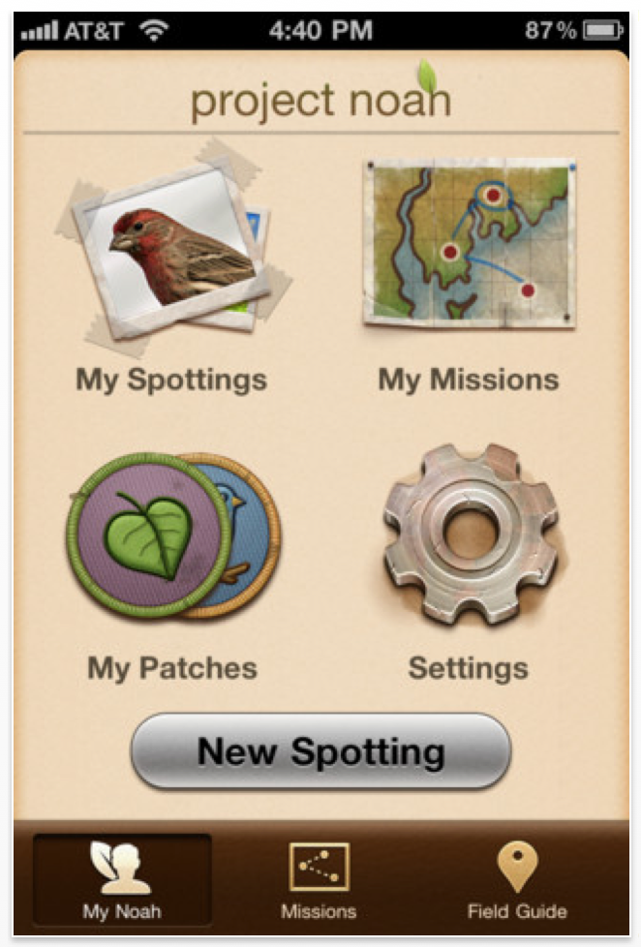
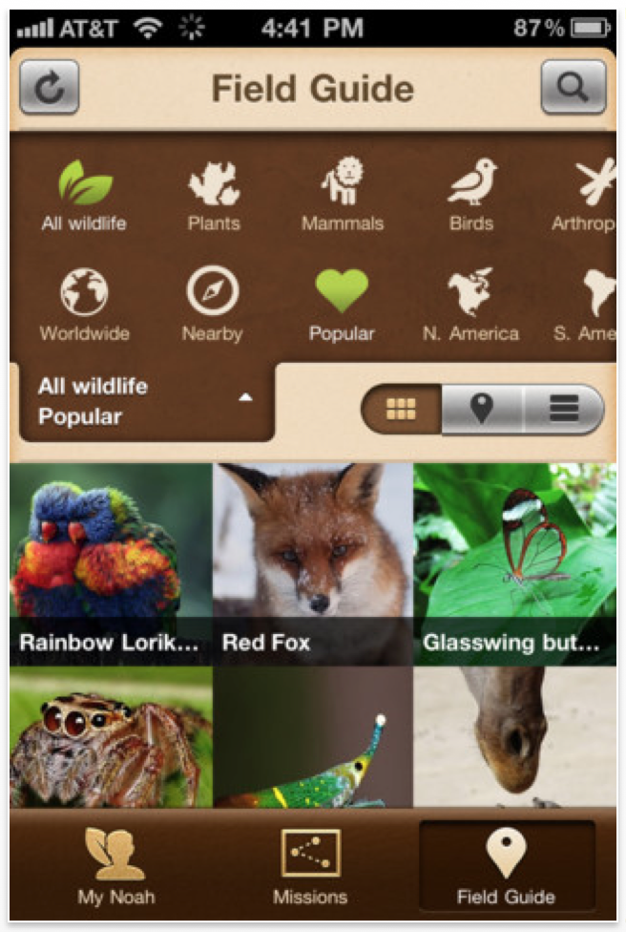
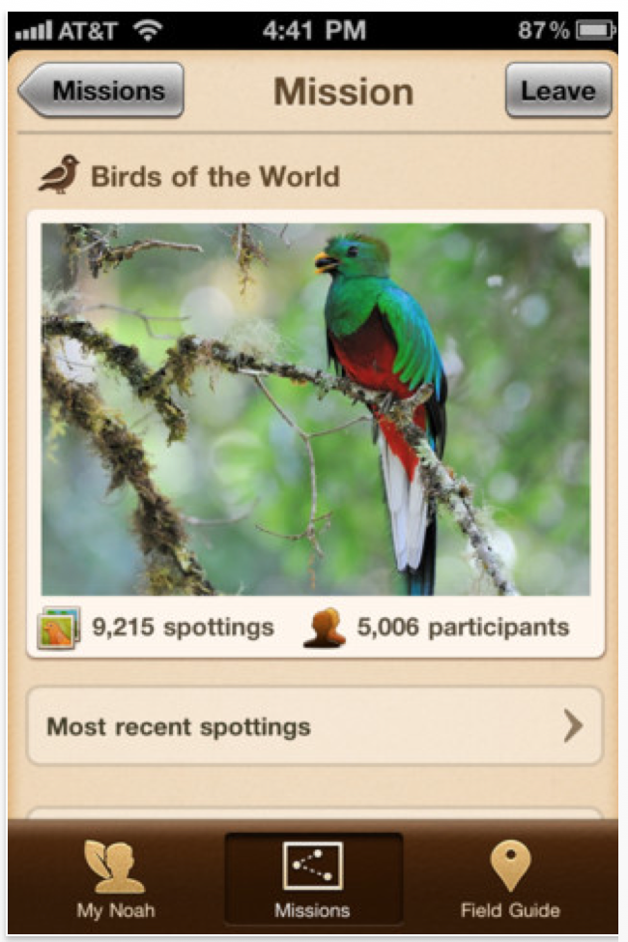
There’s an app for that!
Project Noah

Slide 23
Great way to present real data to your students
In order to create a nugget:
Title
Introduction to the topic - simple
Scientific question
Presentation of data
Graph data
Make claims based on data

