Slide 1
Bug Lyphe! An observational study in biodiversity

Slide 2
Ecosystems and Biodiversity
Definitions:
Define ecosystem:
Define biodiversity:

Slide 3
Ecosystems and Biodiversity
Definitions:
Define ecosystem: a biological community of interacting organisms (biotic) and their physical environment (abiotic)
Define biodiversity: the variety of life in a particular habitat or ecosystem

Slide 4
Ecosystems and Biodiversity
Definitions:
Define ecosystem: a biological community of interacting organisms (biotic) and their physical environment (abiotic)
Define biodiversity: the variety of life in a particular habitat or ecosystem
Not necessarily just number of types, but “evenness” of those types as well!

Slide 5
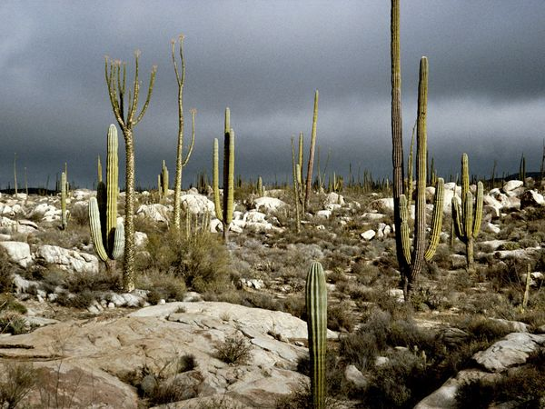
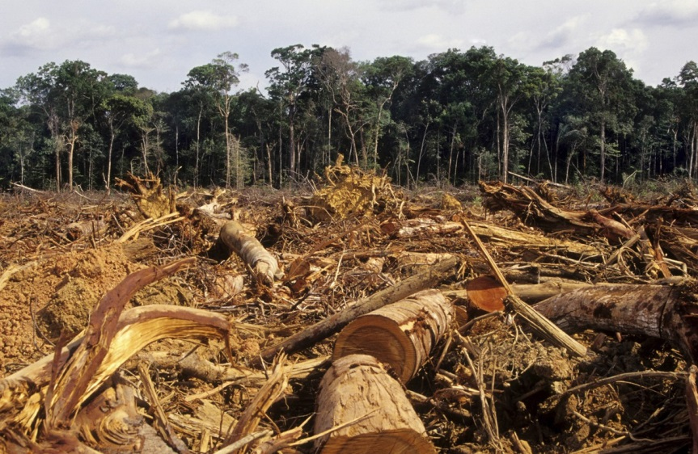
Ecosystems and Biodiversity
How might ecosystems vary in abiotic (non-living) properties or conditions?
How can abiotic conditions affect biodiversity?
How can abiotic conditions be altered?
Notes:
(intended to serve as leading questions)

Slide 6
Ecosystems and Biodiversity
Water availability, windiness, soil types, temperature, precipitation patterns, etc…
How might ecosystems vary in abiotic (non-living) properties or conditions?
How can abiotic conditions affect biodiversity?
How can abiotic conditions be altered?
Notes:
(intended to serve as leading questions)

Slide 7
Ecosystems and Biodiversity
Water availability, windiness, soil types, temperature, precipitation patterns, etc…
How might ecosystems vary in abiotic (non-living) properties or conditions?
How can abiotic conditions affect biodiversity?
How can abiotic conditions be altered?
Nutrient limitation for some organisms, harsh weather conditions affect some populations, etc…
Notes:
(intended to serve as leading questions)

Slide 8
Ecosystems and Biodiversity
Water availability, windiness, soil types, temperature, precipitation patterns, etc…
How might ecosystems vary in abiotic (non-living) properties or conditions?
How can abiotic conditions affect biodiversity?
How can abiotic conditions be altered?
Nutrient limitation for some organisms, harsh weather conditions affect some populations, etc…
Deforestation, severe weather events, carbon emissions, etc…
Notes:
(intended to serve as leading questions)

Slide 9
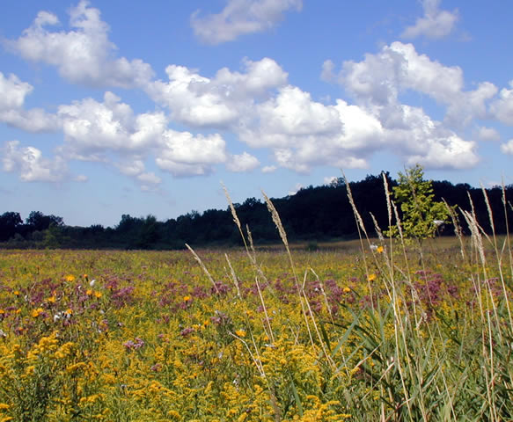
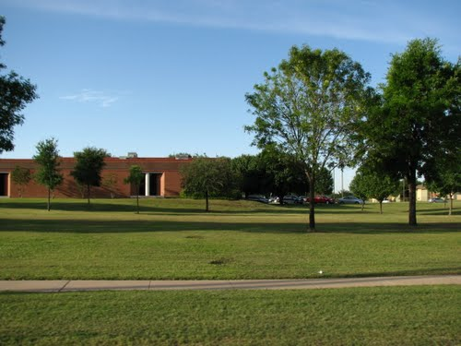
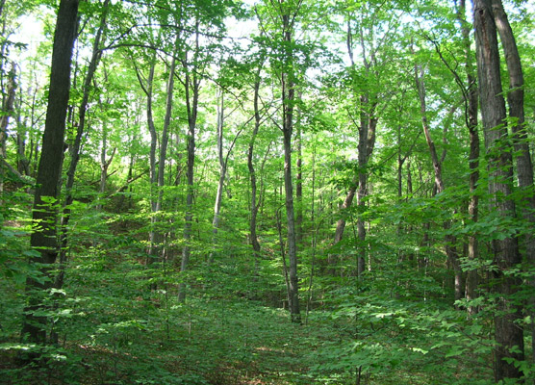
Why might biodiversity vary from one ecosystem or habitat to another?
Notes:
(intended to serve as leading questions)

Slide 10
Ecosystems and Biodiversity
Why might biodiversity be important?
Notes:
(intended to serve as leading questions)

Slide 11
Ecosystems and Biodiversity: Leading Questions
Why might biodiversity be important?
Ecosystem functions
food, fiber, energy
Air and water purification
Pollination and seed dispersal
Ecotourism and recreation
The “insurance hypothesis”
With more species or groups, ecosystems are more likely to maintain function even if some fail due to disturbance, disease, invasion, etc…
Resilience to change
Stability

Slide 12
Invertebrate ID Resources
“What Bug Is That?” poster
KBS GK-12 “Invertebrate Guide” powerpoint
Click here
Bugguide.net
Dichotomous Key for Winged Insects
Click here
Dichotomous Key for Wingless (or Tiny-Winged) Insects
Click here
Image from bugguide.net

Slide 13
Follow-up Questions
Human activities can deliberately or inadvertently alter the equilibrium in ecosystems. How did human activity affect the different ecosystems that we measured?
Your data shows a difference in carrying capacities for the differing ecosystems. Describe the factors that affect carrying capacity in each of the habitats that you measured insect diversity in.
In general, what are the benefits of having high levels of biodiversity in any ecosystem?
How do highly diverse insect populations and communities benefit humans?
5. Was there a difference in the types of insect orders found in the various types of traps? What trends did you notice?

