Slide 1
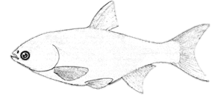
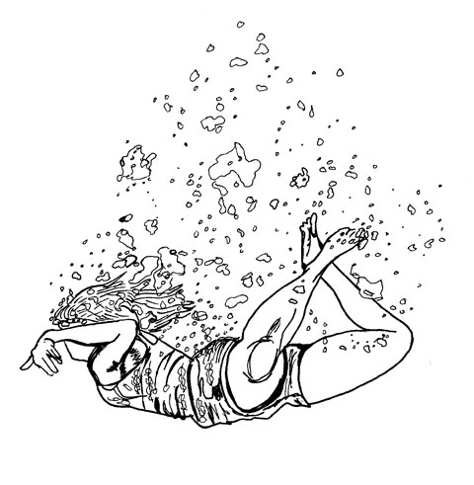
Plenty to eat: If you are the bass move ahead 2. If you are the carp stay here.
START
Catch & release: Go back to START
Polluted water: If you are the bass, move back 2. If you are the carp move ahead 2.
SURVIVAL!
Mark an x in the table for each round’s winner.
Lake freezes: move back 2
Bass
Carp
Round | 1 | 2 | 3 | 4 | 5 | Total

